Slide 1
WAR IN THE TRENCHES
BY: SANJAE, ANGELA, LAURA, AND ELIZABETH

Slide 2
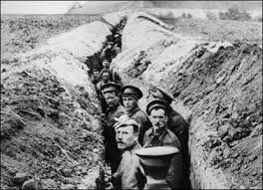
TRENCH CONSTRUCTION
The first trenches in World War 1 were created by the Germans after the Battle of the Marne in September 1914.
The trenches provided necessary protection from artillery shells and machine guns, and gave soldiers a major advantage when holding off a frontal assault. The Germans didn’t want to lose their territory in France and Belgium so the German commander, General Erich von Falkenhayn, ordered his army to dig trenches to defend themselves against their enemy.

Slide 3
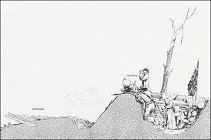
Entrenchment
2 method of digging trenches:
Entrenchment:
Faster method
Allowed soldiers to dig downward a large portion of trench at once.
BUT it it also left the men exposed to the enemy and the dangers that the trenches were supposed to protect them against.

Slide 4
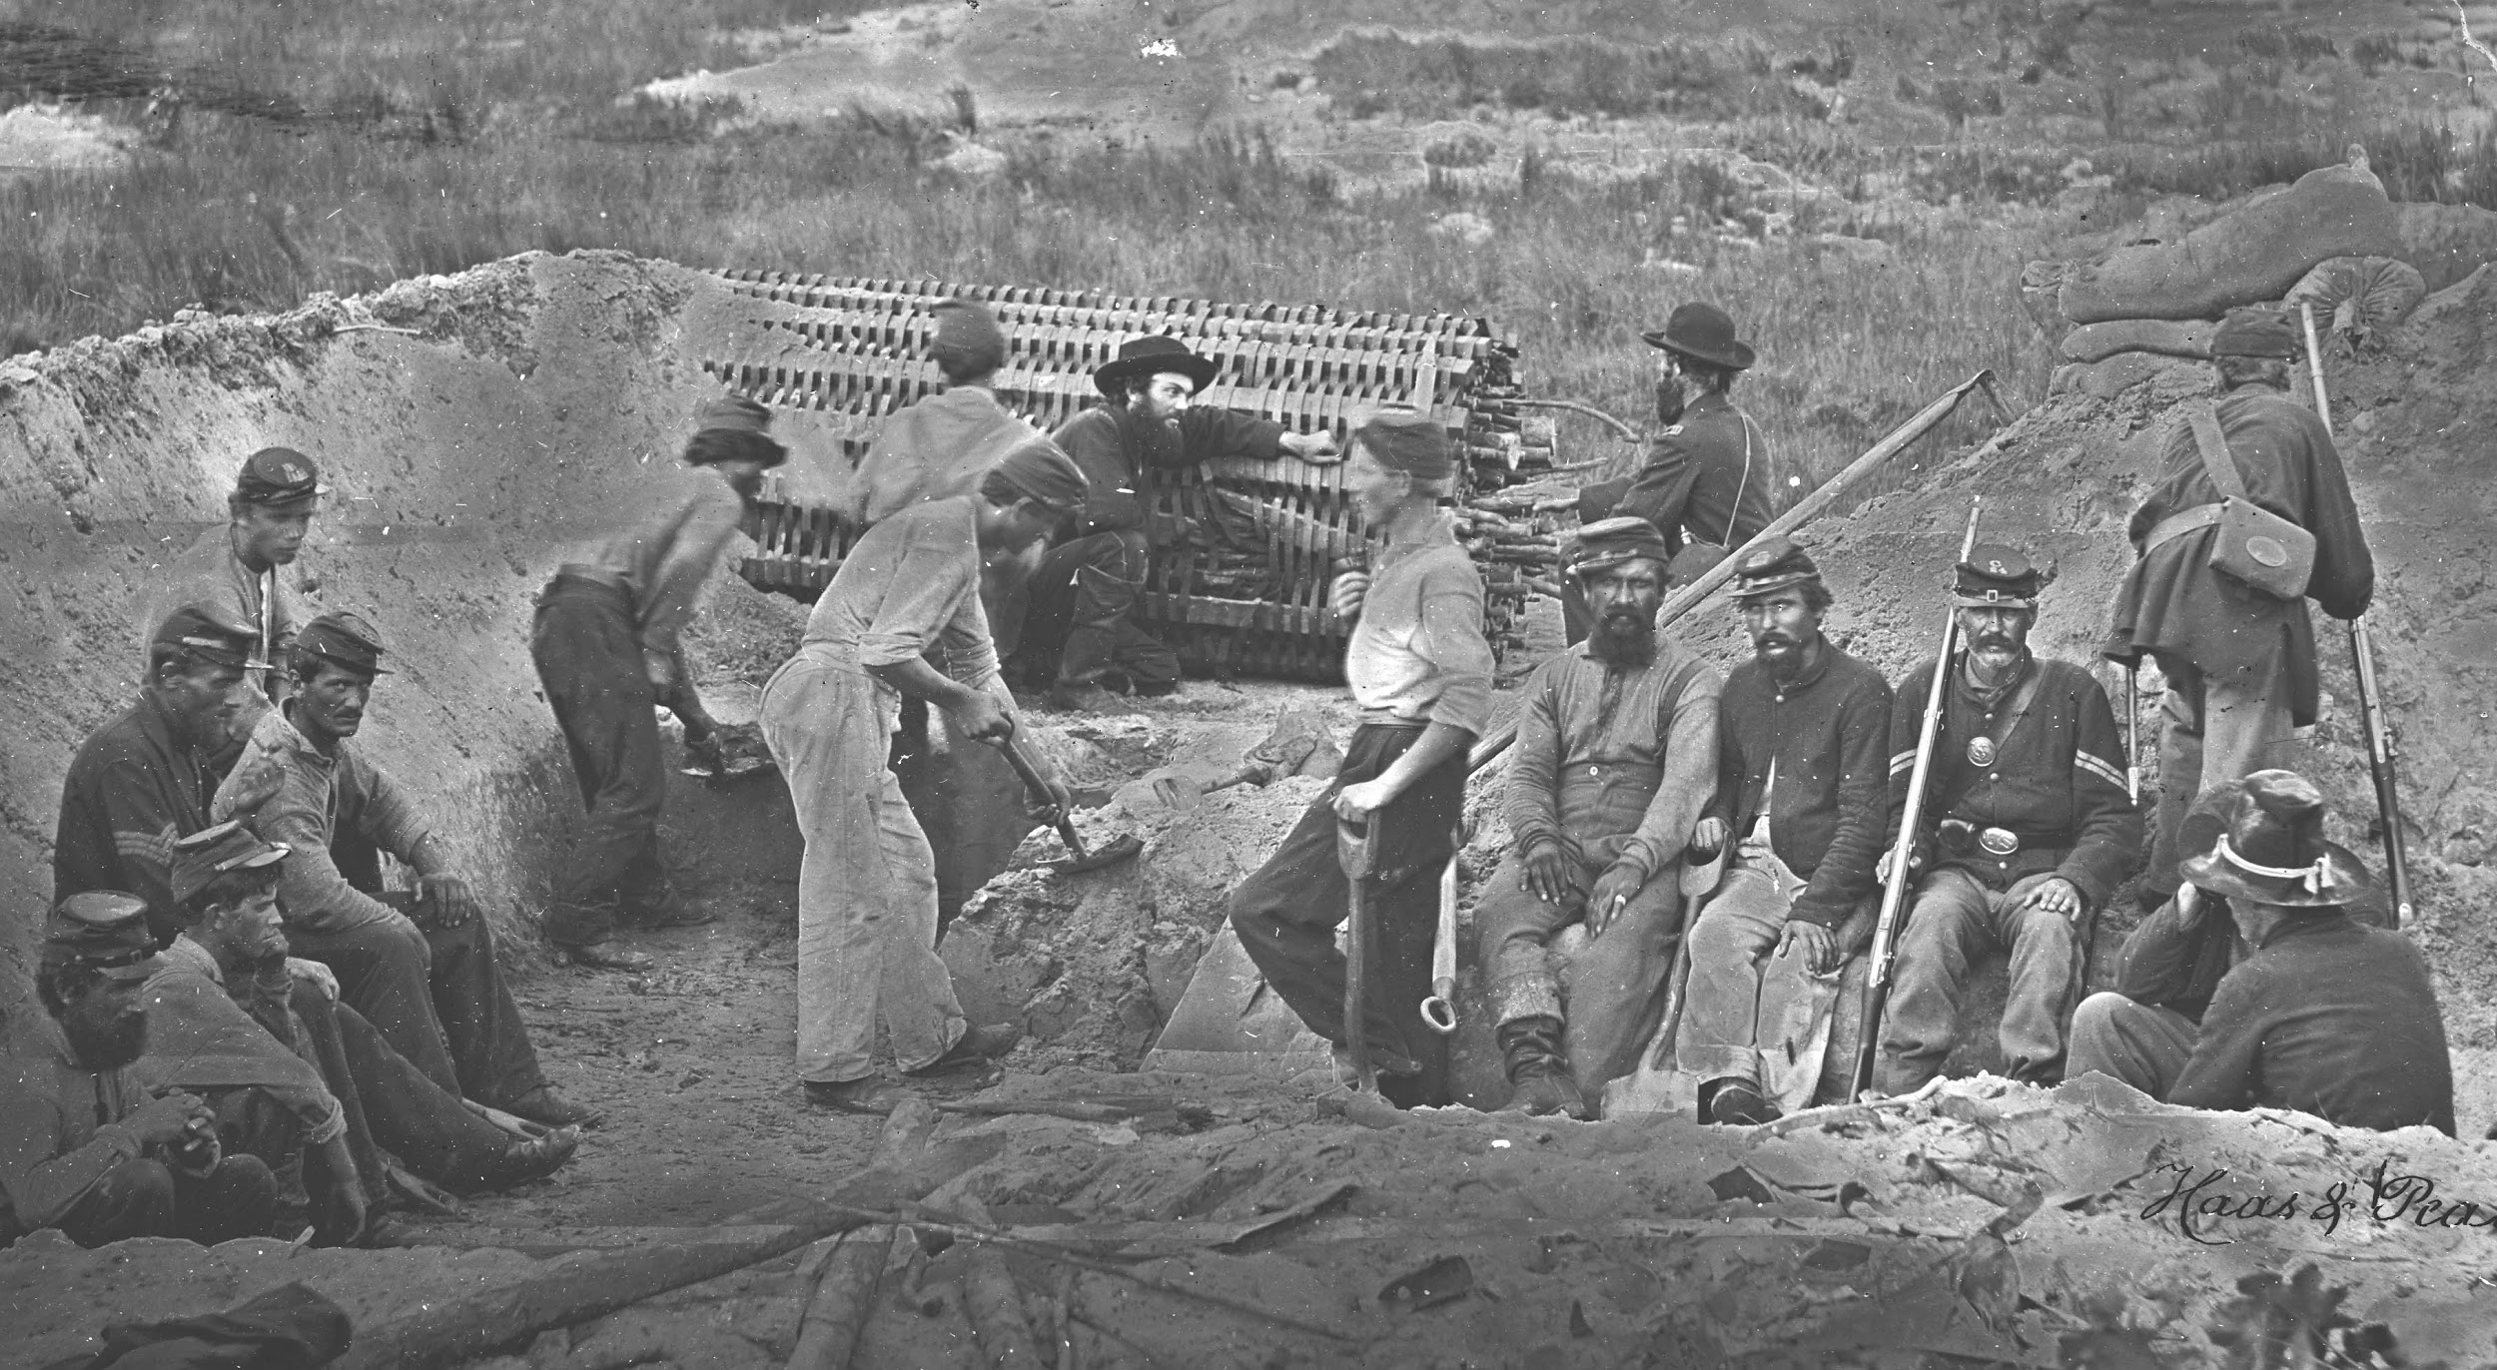
Sapping
When a trench was extended by digging at the end face, going outwards.
Much safer route, but was a slower process since no more than 2 men could fit in to dig.

Slide 5
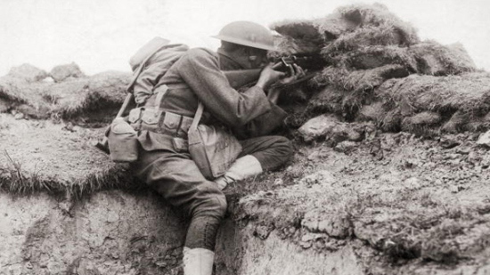
After a trench was built, sandbags, wire mesh, and wooden frames would be brought in to reinforce the walls and to prevent it from collapsing. The floors were covered in wooden duckboards to prevent men from standing in water and to make movement in the trenches easier. To allow soldiers (especially snipers) to see over the trenches, gaps were left in between the sandbags and holes were built into the parapet.
Hole in the sandbag to allow snipers to shoot unnoticed

Slide 6
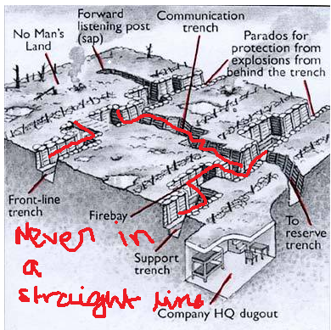
The Layout
About 12 feet deep
Were constructed a zigzag pattern. Never in a straight line because if the enemy invaded their trenches and fired down, every soldier would die.

Slide 7
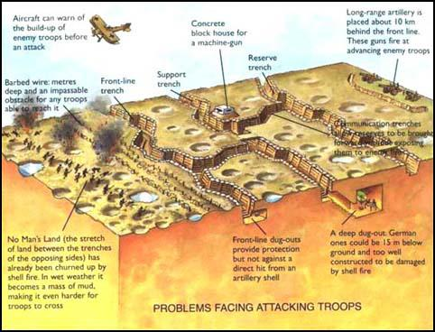
The Layout
Armies mostly built three lines of trenches: the first line of trenches was the front line- the first line of defense.
This line of trenches is the most dangerous as it is the closest to the No Man’s Land/enemy. Sandbags were placed at the opening of trenches as it would prevent bullets from hitting the soldiers.

Slide 8
The Layout
The second line of trench was the support trench/back up for the first line of trench. If the first line of trench was captured, the soldiers from the second line would counter attack.
The third line of trench was the reserve trench. It had emergency troops and supplies in case the first two lines were occupied.
All three of these trenches were connected to the communication trenches which would allow men to bring supplies back safely.

Slide 9
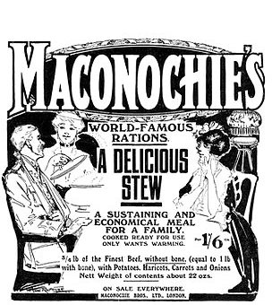
LIVING CONDITIONS
Daily Death
⅓ of the Allied casualties were sustained in the trenches
soldiers died every day even though there weren’t any formal
battles
constant shellfire caused random death
soldiers were killed by snipers
these soldiers that died were called “wastage”
in the 800 strong infantry units, the “wastage” rate per month could get to 10%
Food
given plenty of food at the beginning of war (also had treats from home)
food became limited afterwards - plain bread, tasteless biscuits, pea soup, watery stew
1 meal = “Maconohie’s meat stew” + hard biscuits

Slide 10
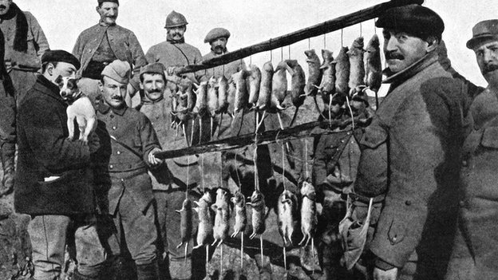
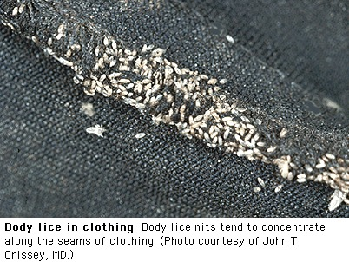
Animals and Pests
Rats
brown rats and black rats
can grow to the size of a cat
1 rat couple can produce 900 offspring per year
spread infection and contaminate food
Lice
major cause of trench fever
breed in seams of clothes, causing people to itch
scrape them off using knife
Others
frogs can be found everywhere
trench covered with red slugs & huge horrific beetles

Slide 11
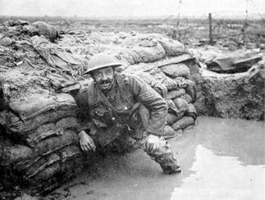
The Bad Smell...
A messy mixture…
dead bodies buried nearby
latrines (toilets) overflow
soldiers unable to bath for weeks or months
cresol/chloride
cordite
poison gas
rotting sandbags
stagnant mud
cigarette smoke
food

Slide 12
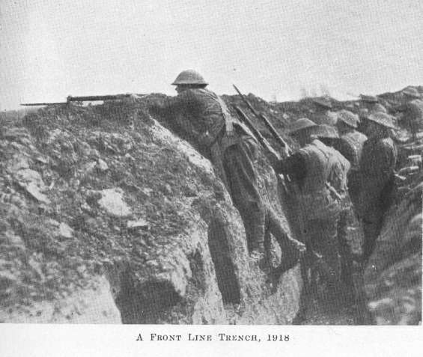
CARING FOR THE WOUNDED
The first World War caused a lot of casualties. The creation of new weapons caused damage that was unknown to doctors at that time. Most soldiers serving in the war were injured during the war. It was highly unlikely that soldiers in the front lines were left uninjured.
How soldiers got sick in the trenches:
Soldiers mostly received wounds from new weapons like machine guns, artillery, and tanks as they would fight on the front line. But those were not the only reasons as to why the soldiers got hurt. Soldiers would also suffer from illnesses and diseases caused by the dreadful conditions in the trenches.
Fighting on the front line

Slide 13
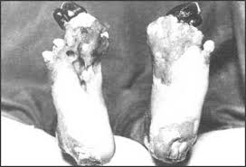
Common Disease
Trench Foot: Soldiers suffered from this condition after standing in water for too long and losing blood circulation.
Trench Fever: This was a disease that was caused by body lice. Symptoms included high fever, headaches, aching muscles and sores on the skin.

Slide 14
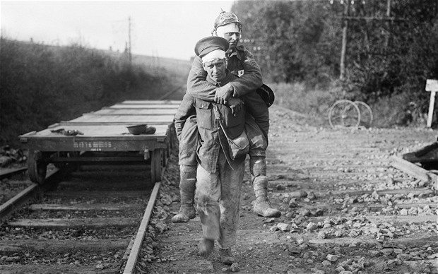
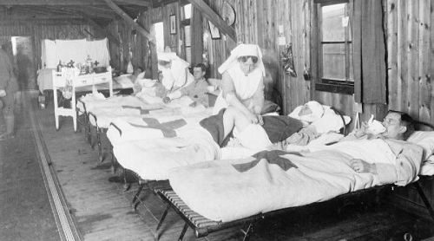
How they were taken care of after they were wounded
After the soldiers were injured or sick they were immediately taken to one of the Casualty Clearing Stations (CCS) to get treated. They were set near the battlefield and the soldiers were taken there after being treated in the trenches. To get soldiers to hospitals, a triage system was used to determine where to put sick soldiers. There were 3 categories:
Slightly Injured: Soldiers who didn’t need much care and after given the treatment, they could quickly go back to the war.

Slide 15
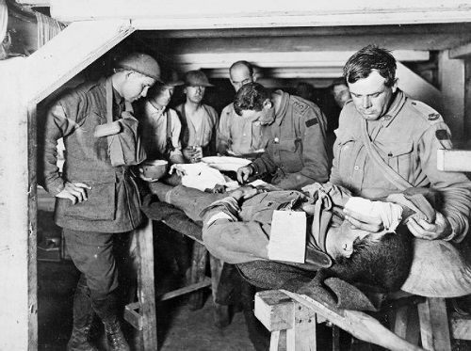
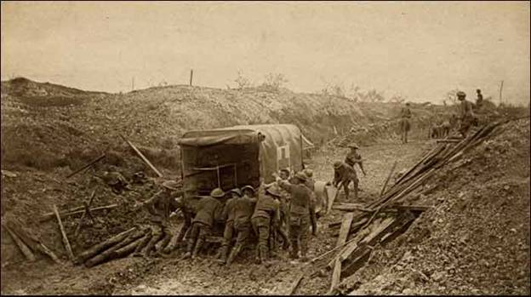
How they were taken care of after they were wounded
2. Need Hospital: These are the soldiers who were badly injured and needed to have their leg or arm amputated. They were transported to the hospital as soon as possible.
3. Beyond Help: These are the soldiers that had no chance of getting better so they were given enough treatment to make them comfortable, but the priority was given to other soldiers.

Slide 16
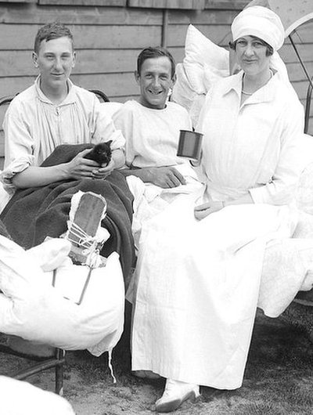
Women on the Frontline
There were also some female volunteers who wanted to help during the war. They were given permission to work as a nurse in the clearing stations (and some even drove the ambulances). Most of the nurses worked for 14 hours or even longer. The soldiers liked having nurses around since they reminded them of homes, their mothers, their sisters and their wifes.

Slide 17
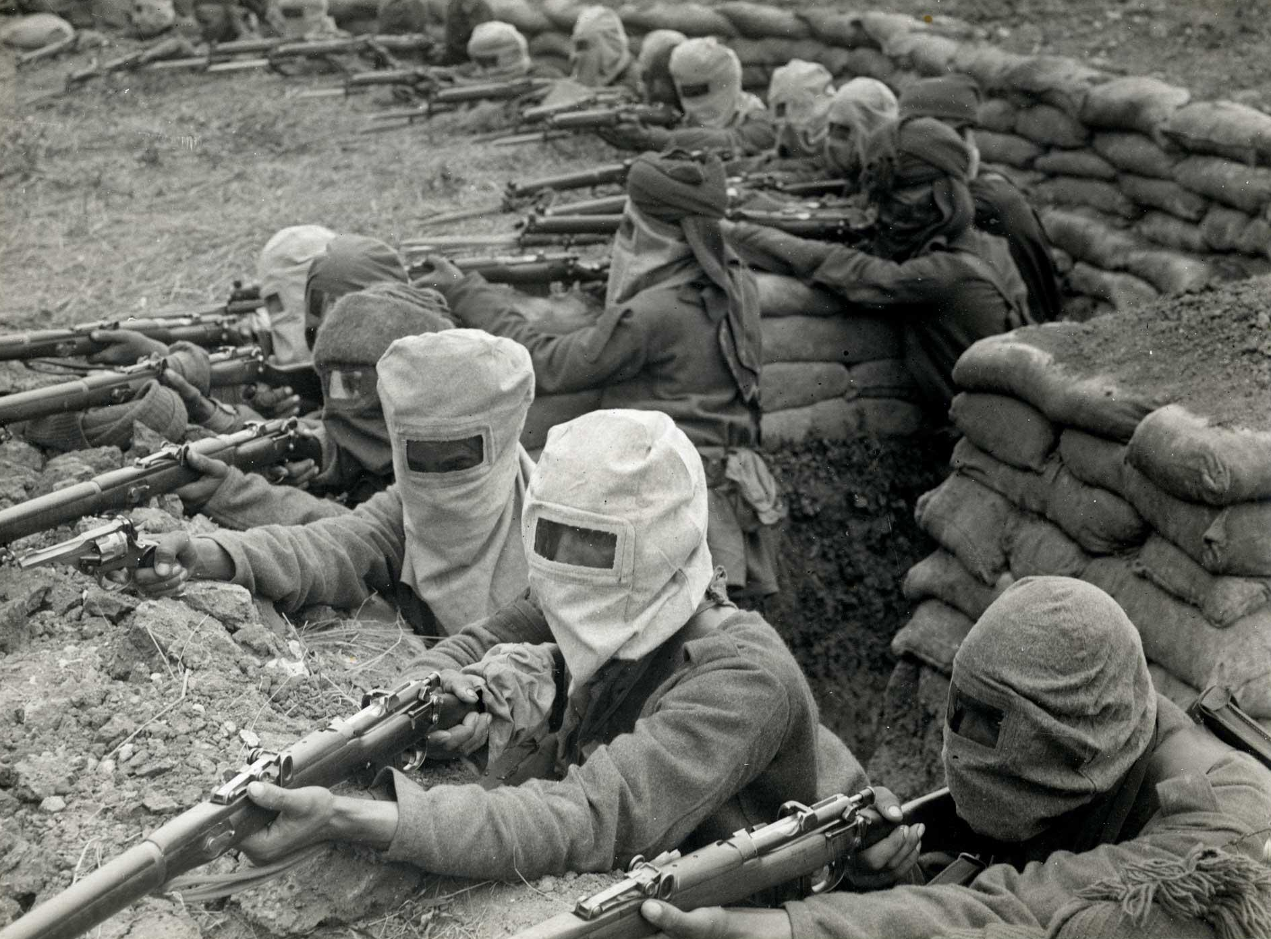
DAILY LIFE
5 a.m.
“Stand-to” half an hour before daylight
“Stand-to” : to be on high alert for enemy attack.
5:30 a.m.
rum ration.
6 a.m.
stand-to half an hour after daylight
7 a.m.
have breakfast (e.g. British would have bacon and tea)
breakfast time = unofficial truce

Slide 18
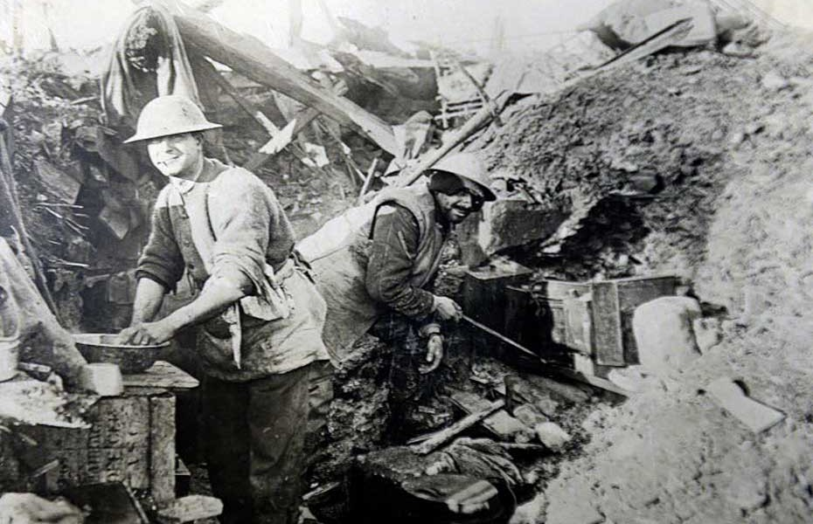
Daily Life
after 8 a.m.
inspection, assign chores
tidy up trench, clean weapon, clean themselves
12 p.m. noon
lunch - bread or biscuits, and soup.
after noon
the downtime, only one man per ten would be on duty, being on watch to be alert for any sign of attack.
some would sleep, some would write diaries or letters, some would continue to do chores.
sleep at post = crime!

Slide 19
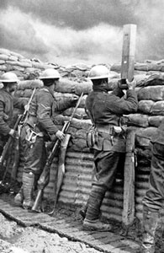
Daily Life
5 p.m.
tea time
6 p.m.
stand-to half an hour before dusk.
6:30 p.m.
stand-to half an hour after dusk.
6:30 p.m. onwards
work all night, some time for rest
dig trenches, get stores, patrol and put up barbed wire at No Man’s Land
No Man’s Land: the blasted landscape separating the two armies
enemy patrols met: quickly move / fight

Slide 20
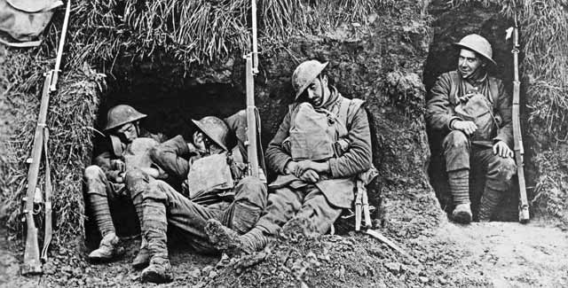
Sleep
slept in clothes
not a lot of time to sleep at night
unable to get good sleep “Whilst asleep during the night, we were frequently awakened by rats running over us. When this happened too often for my liking, I would lie on my back and wait for a rat to linger on my legs; then violently heave my legs upwards, throwing the rat into the air. Occasionally, I would hear a grunt when the rat landed on a fellow victim.”
------ R L Venables
slept whenever possible, even if there’s just 2 - 3 minutes

Slide 21
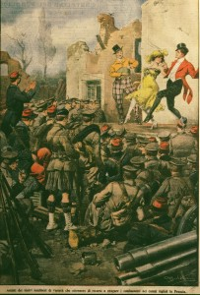
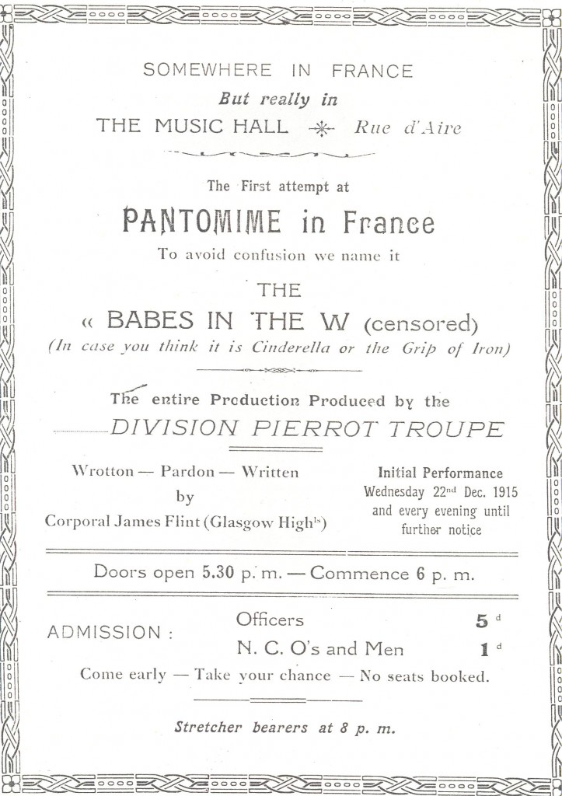
ENTERTAINMENT
read letters from home, write letters to home
write diaries, journals
play cards or gamble - if they were lucky
tell jokes, puns
sang satirical songs when marching, in the front line, in the trenches famous songs: It’s a Long, Long Way to Tipperary and Keep the Home Fires Burning
later in war: division concert parties and entertainment troupes
1914 Christmas Truce - a special Christmas celebration at the trenches both side of the Trenches agreed to have a truce and had a football match (it is said that the Germans won the game) Germans and English exchanged food as a Christmas gift

Slide 22
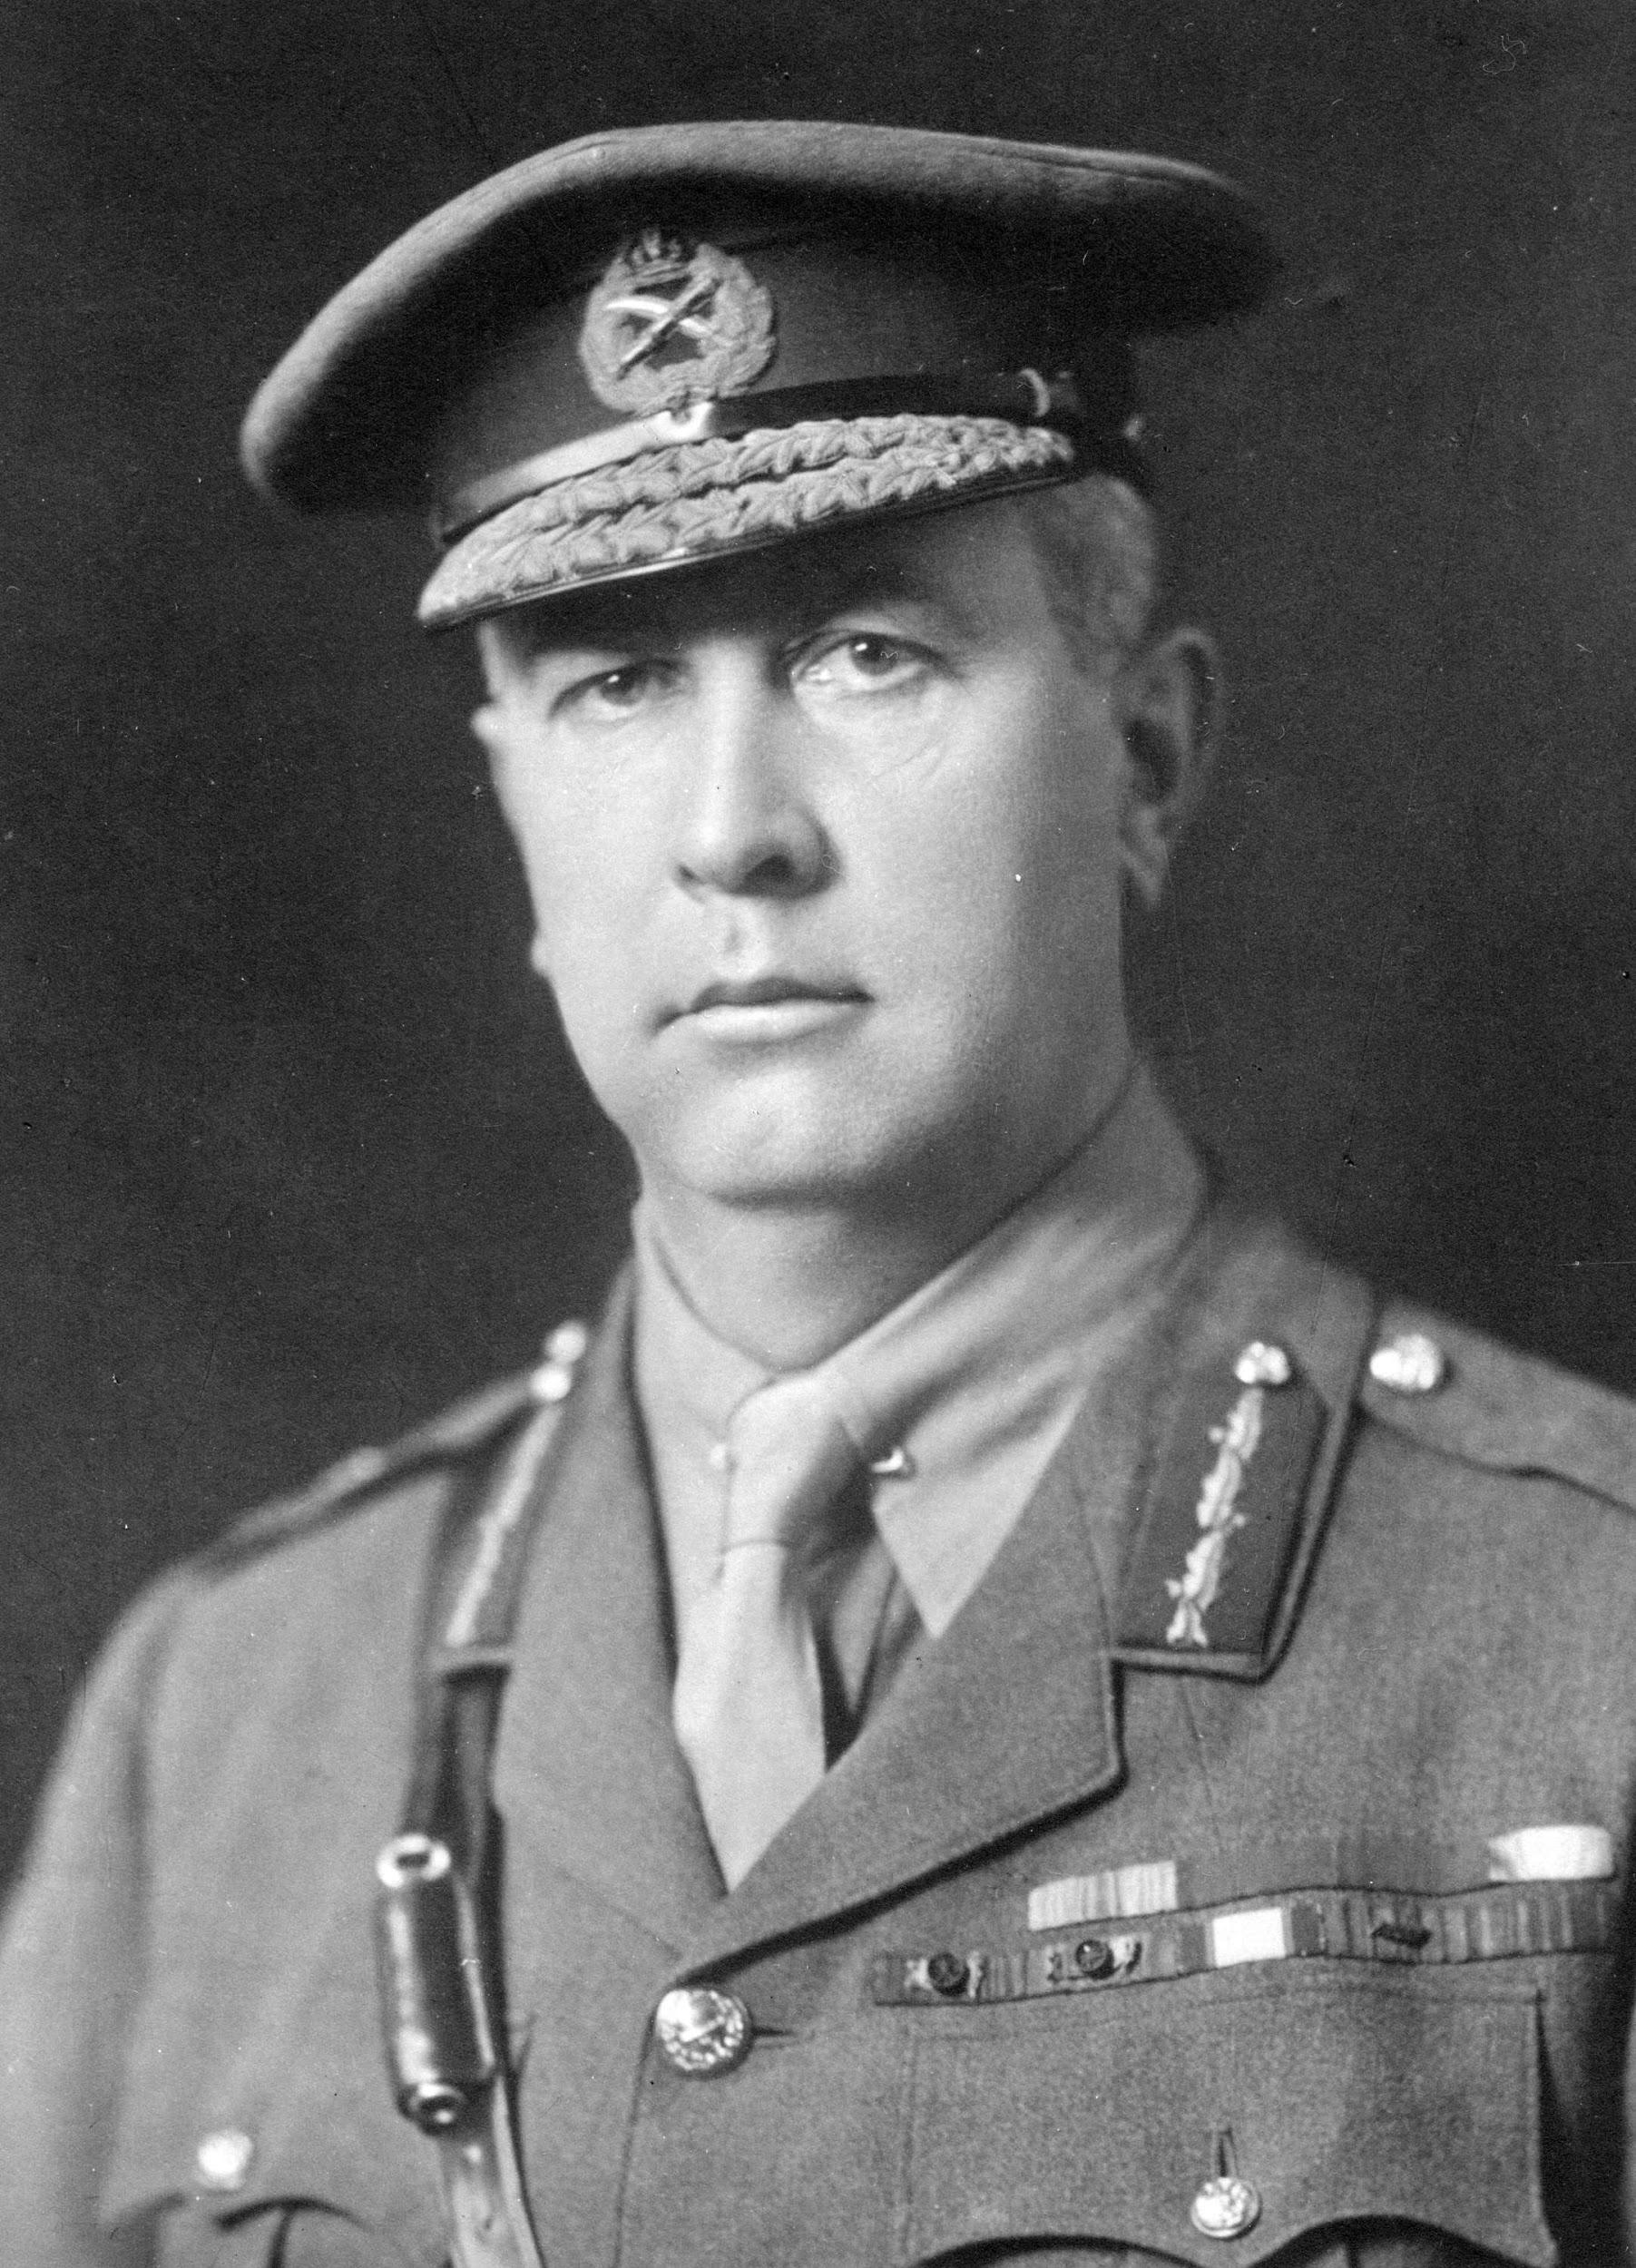
Arthur Currie : Profile
first Canadian commander of the Canadian Corps during WWI
helped them achieve many important victories in the war
no actual professional experience at the start of WWI
widely considered one of the ablest generals in the war

Slide 23
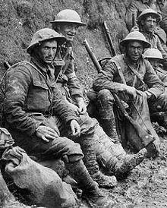
Arthur Currie : Profile
helped Canadian soldiers create their reputation as fierce soldiers
unbroken string of major victories in 1917-1918
never sent his troops into battle unless he knew they were ready
June 9th, 1917- became commander of the Canadian Corps and was knighted

Slide 24
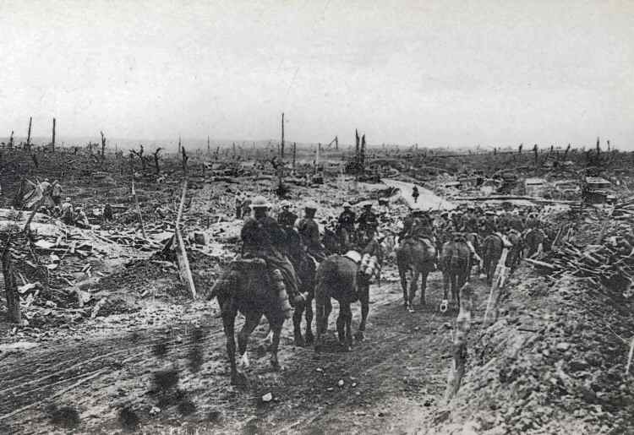
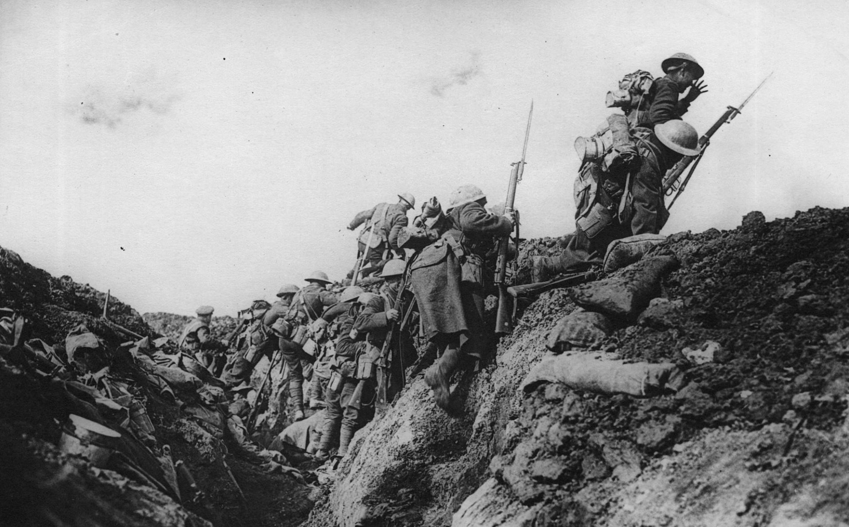
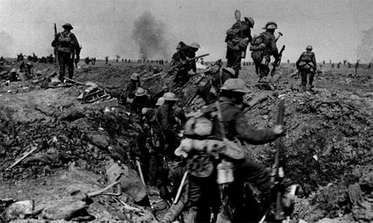
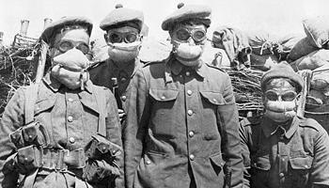
Arthur Currie : Battles
Currie’s division carried out a successful counterattack against the Germans at Mount Sorrel
The Canadians won against odds at the Battle of Vimy Ridge, a victory executed by Currie and his men
April
1917
April/May
1915
June
1916
Currie’s brigade lost about half of its strength during the Second Battle of Ypres
Currie’s division suffered heavy losses and little gain at the Battle of the Somme
September
1916

Slide 25
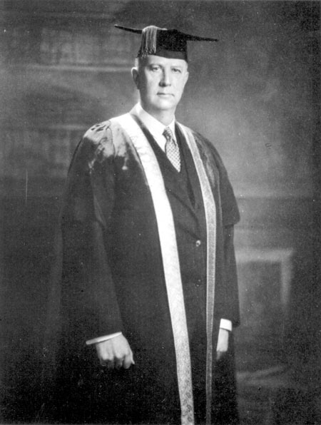
Arthur Currie : Post - WWI
August 1919- appointed inspector general of the militia forces in Canada
May 1920- became principal and vice-chancellor of McGill University
however, the controversy around his embezzlement took its toll
after several years of bad health, he had an eventually fatal stroke in November 1933 and died later that month at the age of 58

Slide 26
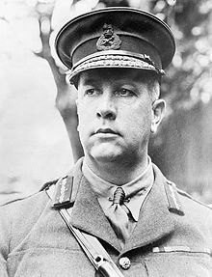
Arthur Currie : Quotes
“We have shown that even in trench warfare it is possible to mystify and mislead the enemy.”
“Thorough preparation must lead to success. Neglect nothing.”
“I am a good enough Canadian to believe, if my experience justifies me in believing, that Canadians are best served by Canadians.”

Slide 27
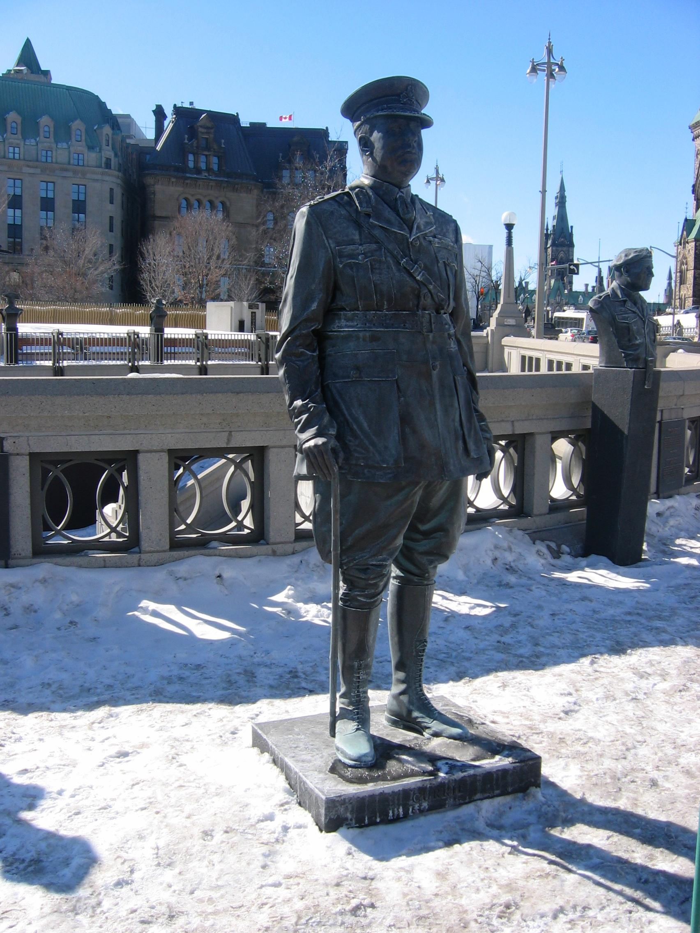
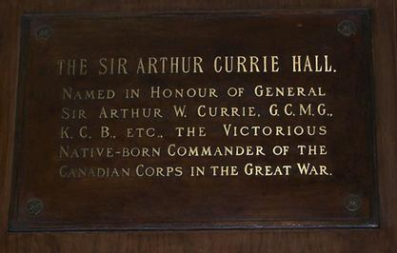
Arthur Currie : Legacy
Sir Arthur Currie Hall plaque Currie Hall at the Royal Military College of Canada
Arthur Currie statue at the Valiants Memorial in Ottawa

Slide 28
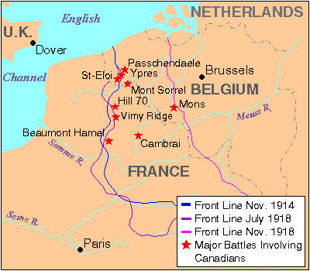
IMPORTANT CANADIAN BATTLES
Here are some of the important battles:
The Second Battle of Ypres
The Battle of Mount Sorrel
The Battle of Somme
The Battle of Courcelette
The Battle of Vimy Ridge
The Battle of Hill 70
The Battle of Passchendaele
The Battle of Amiens
The Battle of Cambrai
The Battle of Mons

Slide 29
THE END
THANKS FOR LISTENING!!

