Slide 1
World War I
War of Attrition

Slide 2
The Effects of New Technology
Prior to WWI, the last major European war was in 1870
Significant changes in weapons had occurred since then – weapons had become far more destructive and effective
Military strategists were slow to adjust their tactics to these new weapons

Slide 3
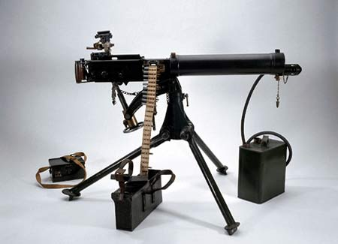
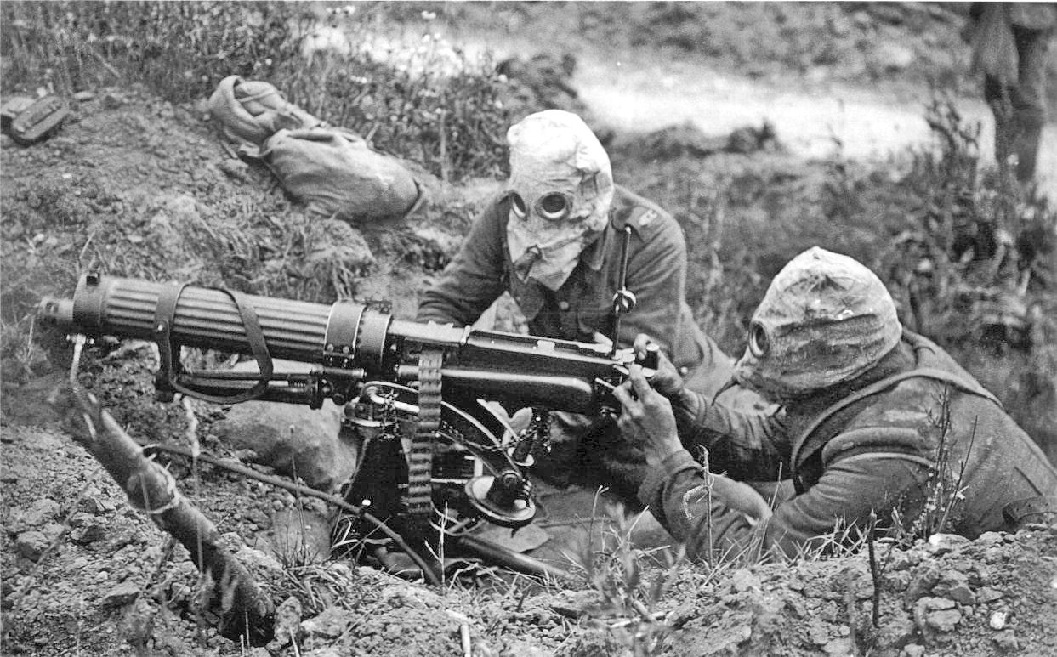
Machine Gun
Powerful defensive weaopn
made attacking enemy trench virtually impossible
Very rapid fire
1914: 400-600 rounds per minute
1918: over 1000 rounds per minute!
This was a weapon of mass slaughter: 1 machine gun = 80 rifles!
Example: Battle of Somme, 1916 at Beaumont Hamel nearly 800 soldiers of the Newfoundland Regiment were killed in just 20 minutes

Slide 4
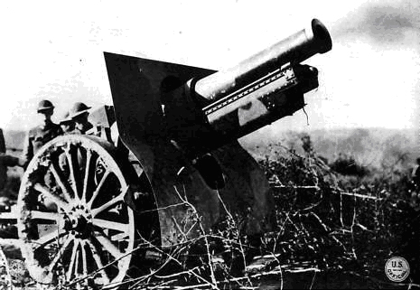
Long Range Artillery
Artillery refers to cannon
New advances meant that cannons could now be loaded from the read with massive cartridges
Fire more frequently, longer range and more destructive - High explosive shells
Used as offensive weapon – attack enemy trench
Cut barb-wire & destroy trenches

Slide 5
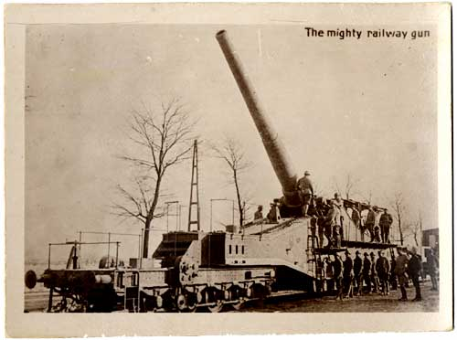
Railway Gun

Slide 6
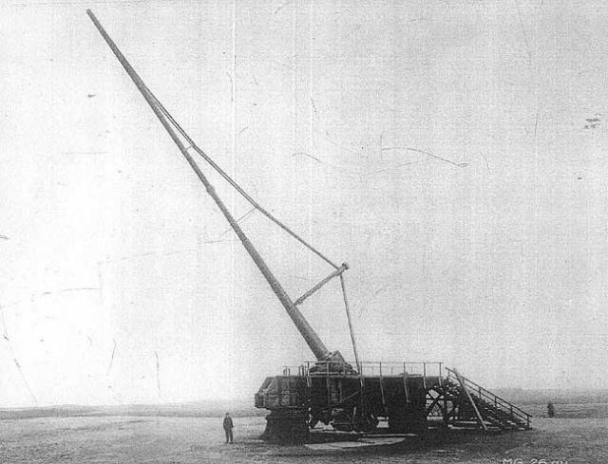
Paris Gun: German
Could fire a 106 kg shell 130 km

Slide 7
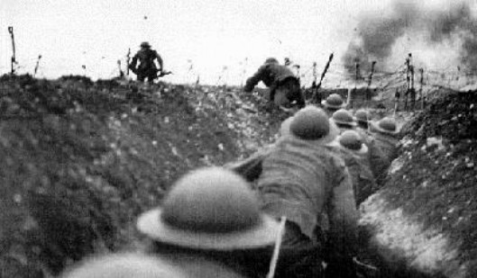
Effect: Trench Warfare & War of Attrition
These weapons were terribly destructive
The effect of these developments was Trench Warfare – trenches were the only place a soldier could take cover
Trench construction took on significant importance as war raged on
Elaborate designs, tunnels and underground bunkers were constructed

Slide 8
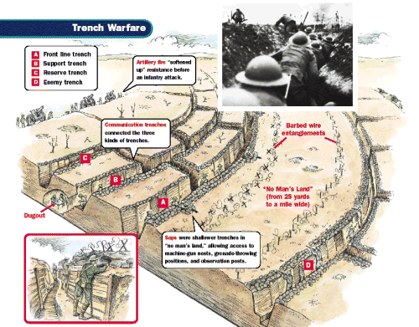
Trench Construction

Slide 9
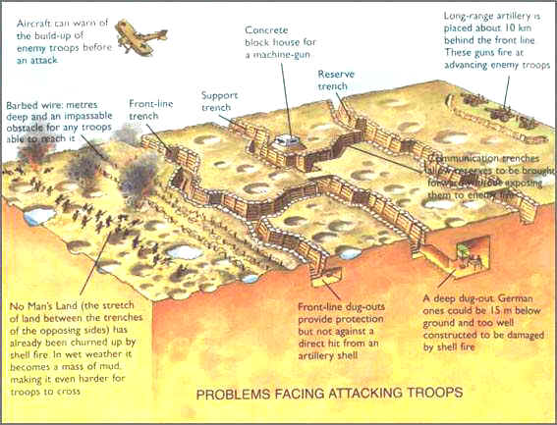
WWI Battle Field

Slide 10
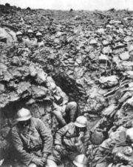
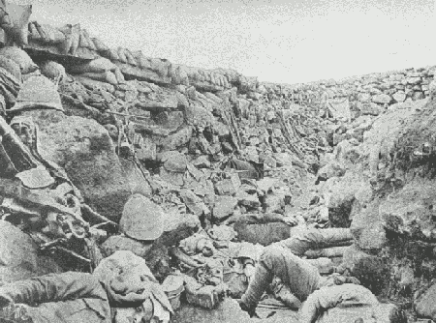
Trenches II

Slide 11
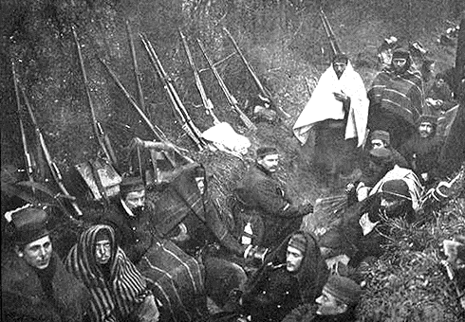
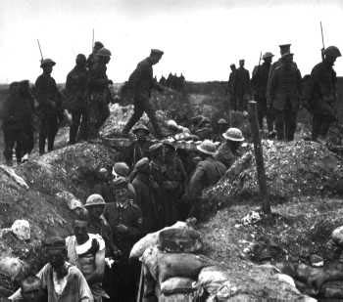
Trenches III

Slide 12
Trench Life
Trench life was horrific – a soldier was always wet, hungry, and in danger of being killed at any moment
Shell shock – Post Traumatic Stress Disorder – was not yet a recognized mental illness
No-mans land – the battlefield between enemy trenches, was littered with the dead and dying
Rats and disease were widespread

Slide 13
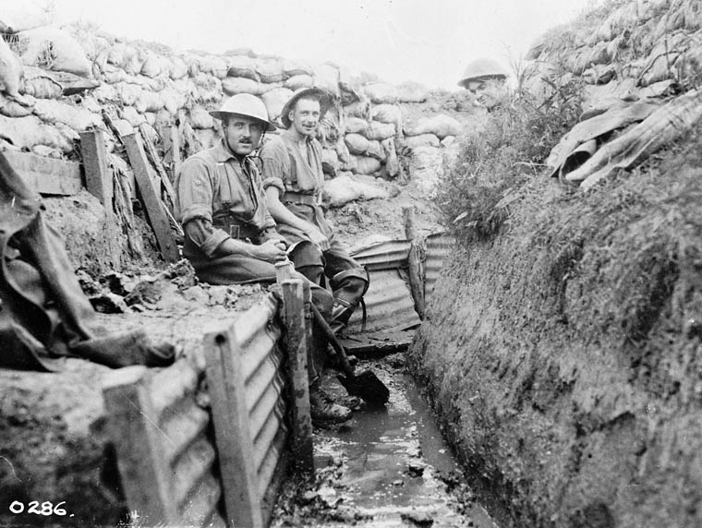
Life in the trenches

Slide 14
War of Attrition
Basic strategy – bomb enemy trench – send men “Over-The Top” –
Soldiers faced a hail of shrapnel caused by artillery and machine gun fire
Inevitably the attack fizzles out – DO IT AGAIN!
This strategy demanded more men, more ammunition and more supplies
11 major offensives each lasting months at a time

Slide 15
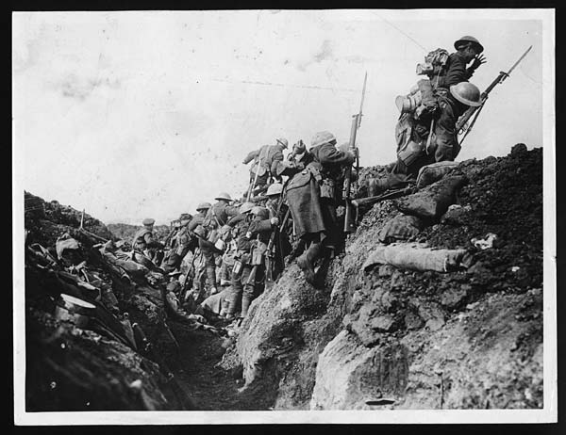
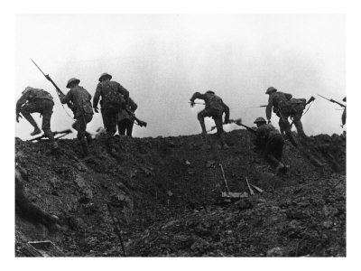
Going “Over The Top”

Slide 16
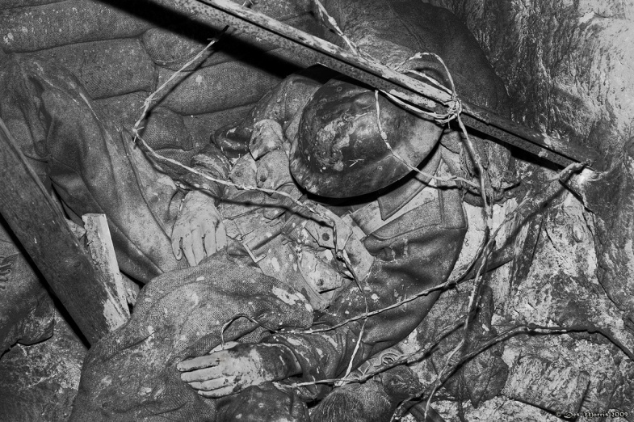
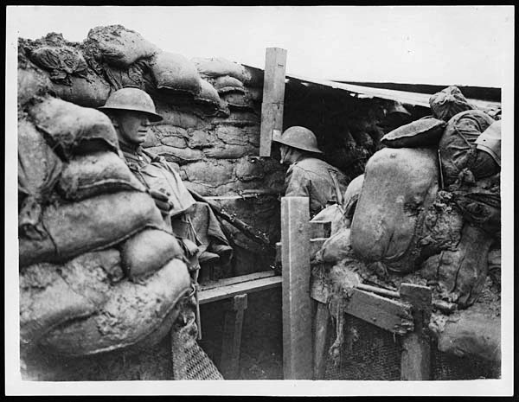
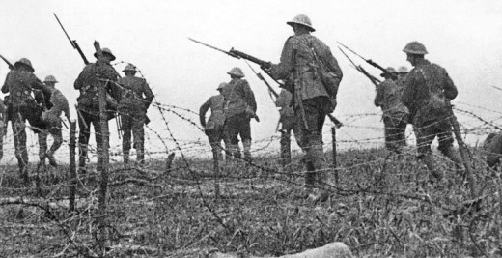

Slide 17
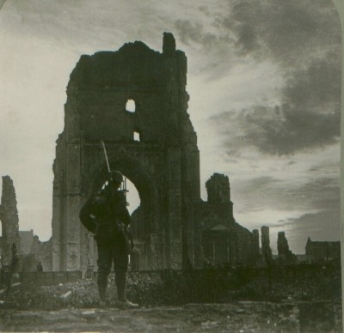
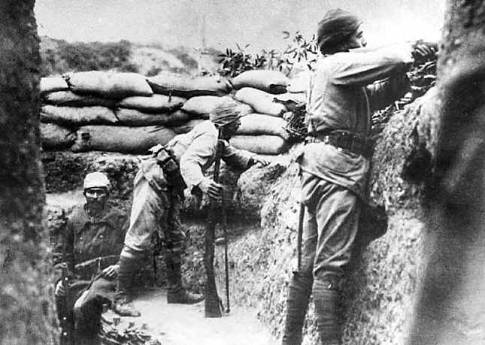
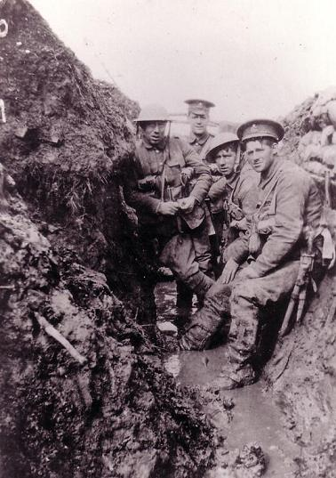
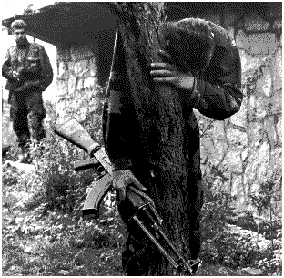
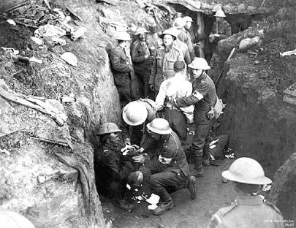
Pictures of World War One
Some pictures of trenches and the destruction caused by world war one

Slide 18
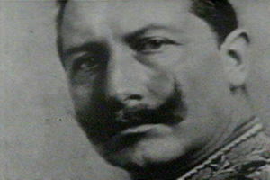
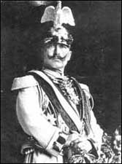
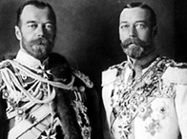
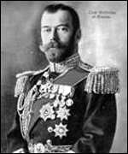
People Responsible for World War One
King George V, Czar Nicholas II and Kaiser Wilhelm II

Slide 19
Trenches
http://techcenter.davidson.k12.nc.us/Group9/trenchwar.htm

Slide 20
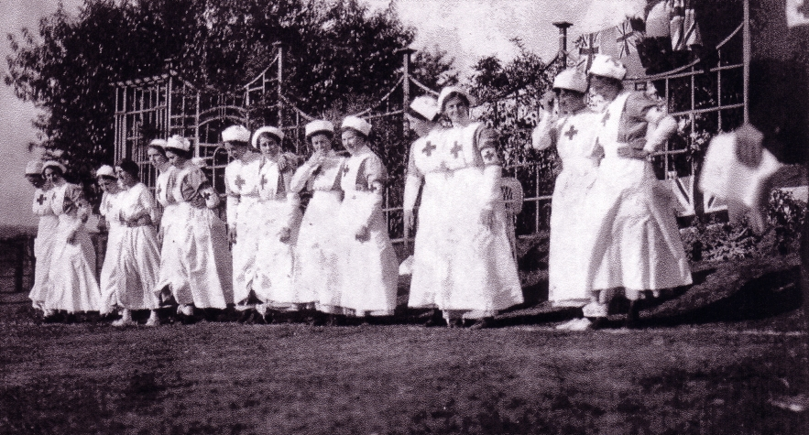
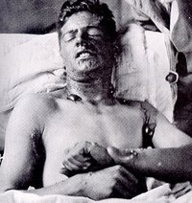
Wounded and Nursing in the War
Nurses in the war
A soldier wounded by mustard gas some wounds will be permanent

Slide 21
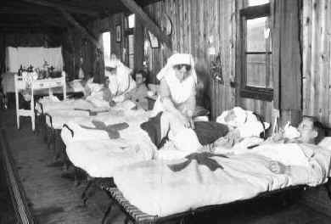
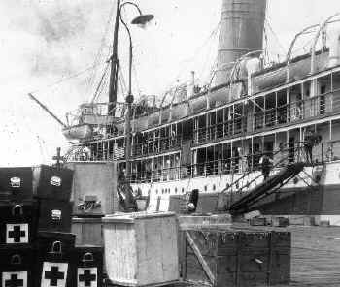
Wounded Soldiers in the War
Nurses taking care of wounded soldiers (top left) and soldiers wounded behind the lines waiting for medical attention (bottom left)
Cargo ship bringing medical suppliess to the war front (bottom right)

