Slide 1
Social Identity and Role Theory
Sidney ・ Uday ・ Michael ・ Raphael

Slide 2
Part A

Slide 3
Social Identity
Social Identity: how you define yourself to those around you and yourself - Changes throughout life
Responsible for many behavioural shifts
Conformity causes us to desire a certain social identity - process of changing behaviour, thoughts, or feelings to adhere to a group/authoritative standard
A reciprocal relationship of confirmation is created between the individual and society - interactions → experience

Slide 4
Influences
Gender
Culture
Age
Social Class

Slide 5
Young Single Adult
Newly Married
Couple
Family with
Young Children
Family with
Adolescents
Family in
Mid-life
Family in
later life

Slide 6
Part B
Part B

Slide 7
Structural Functionalism
Influenced mainly by the ideas of Emile Durkheim, the structural functional theory states that a society is stable when social institutions meet the needs of its citizen
It mainly emphasizes on interdependence within a society and “function within function.”
This theory even though holds the importance of examining the roles of an individual in the functioning of the society, it however fails to see the intercultural and interracial differences in individuals
It does not address the problems like discrimination and does not see individuals as self reliant

Slide 8
Structural Functionalism
In structural-functionalist thought, individuals are not significant in and of themselves but only in terms of their social status i.e. their position in patterns of social relations - On the other hand, the social identity theory has elements like culture, race, gender and class which an individual has to mould to
Similarly, the social role theory is micro-sociological focusing on the individual behaviour in the society rather than the functioning as a whole

Slide 9
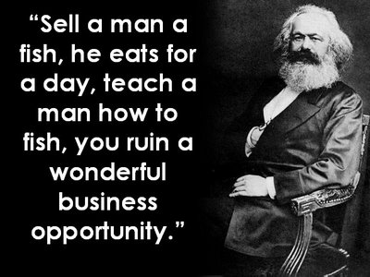
Conflict Theory
According to conflict theory, put forward by Marx, society is fragmented into groups that compete for social and economic resources. On the other hand, the social identity theory states that different groups (“in group” and “out group”) compete for self -esteem
Thus, both theories are developed on the idea of competition leading to prejudice and conflict
According to conflict theorists, the conflict arises between any two groups who are unequal leading to concepts like racism, groupism, sexism etc
Both the conflict theory and the social identity theory use a group approach in explaining prejudice and discrimination rather than an individual approach

Slide 10
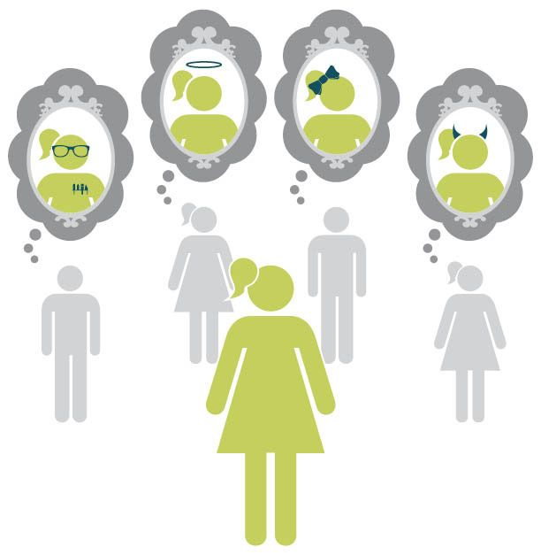
Symbolic Interactionism
Symbolic interaction is a theory which is most closely related to self identity and role
It analyses the individual on a microscopic level and along with symbols, meaning, and interaction; the self is a basic concept in symbolic interactionism
This theory emphasizes the role of others (significant other and generalized other) in development of self, similar to what an individual does throughout their life cycle while creating self identity

Slide 11
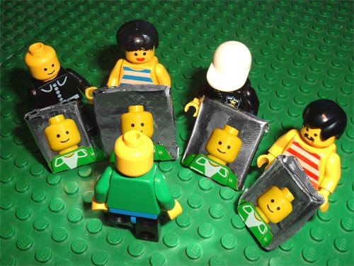
Symbolic Interactionism
The symbolic interaction theory states that we accept roles for ourselves in order to fit into the society in which we live; similar to role theory according to which we have expectations that are attached to particular social positions
Socialization is not a passive process of learning roles and conforming to other's expectations - The self is highly active and selective, having a major influence on its environment and itself

Slide 12
Part C
Part B

Slide 13
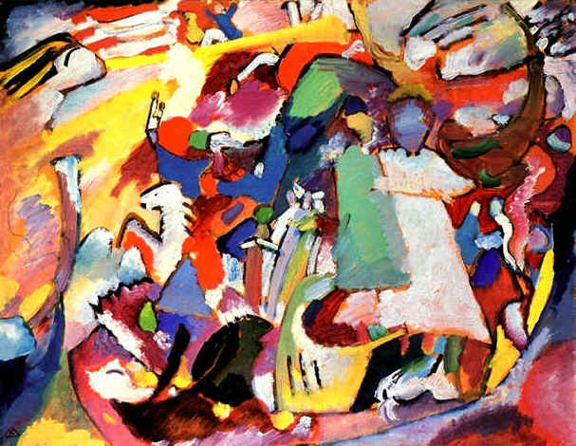
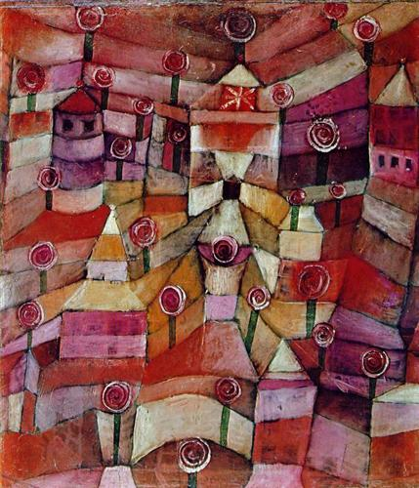
Henri Tajfel - Experiment
Group of 14-15 yr. old boys were asked which of two paintings they liked better
Boys were divided into 2 groups; they were told it was based on their answers
After being divided, each boy was given play money to distribute to all the boys - Could divide the money however they wanted
Boys favoured their own group by the end of the experiment (gave them more money)
Tajfel provided no reward to the boys for doing this
All Saints Day I by Wassily Kandinsky and Rose Garden by Paul Klee

Slide 14
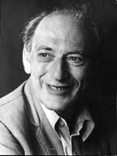
Henri Tajfel - Results
Even with very little influence, people are willing to join groups and accept their values/beliefs
Social Identity Theory: one’s identity is formed, in part, from joining and participating in groups
Group membership involves protecting the group’s welfare and its values
Henri Tajfel

Slide 15
Henri Tajfel - Results
Reward System 1
Total money distributed has to equal $25
Most of the time, one group member was given a lot more money than the other
Reward System 2
4 significant options - max. profit for one’s own group (1st row) - max. equality (2nd row) - max. combined profit (3rd row) - max. difference in profit (4th row)
Klee Group Member 12 | Kandinsky Group Member 6
1 | 14
5 | 10
7 | 8
8 | 7
10 | 5
14 | 1
Klee Group Member 12 | Kandinsky Group Member 6
19 | 21
13 | 13
17 | 25
7 | 1

Slide 16
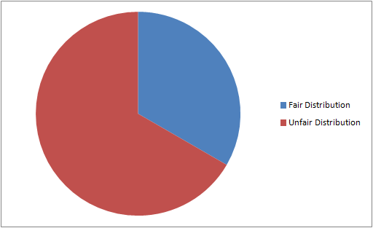
Henri Tajfel - Results
Cases of Fairness in Money Distribution for First Example Using Reward System #1
In this example, most cases were favouring one group over the other
This trend continued throughout the experiment - most boys chose the option that would favour their group the most

Slide 17
The Measurement of Role/Identity
“The Measurement of Role/Identity”: 1977 study by Peter J. Burke and Judy Tully - Study on middle school students and their beliefs about gender identities - asked to describe either boys or girls with descriptors like weak, strong, emotional, or not emotional
Study discovered that children who had cross-sex identities were more likely to have deflated self-esteem - Cross-sex identity: identifying one’s self in a similar way to that of the opposite gender

Slide 18
Part D
Part B

Slide 19
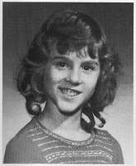
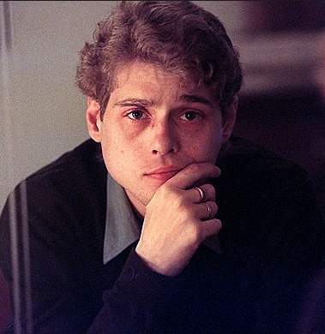
David Reimer
Bruce Reimer and his brother were circumcised at a very young age and the procedure went horribly wrong causing his genitals to be damaged and beyond repair
Bruce’s parents decided to bring Bruce up as a girl because of this
Although they removed his genitals and tried to bring him up as a woman, Bruce’s personality was not that of a woman which clearly proves that men and women are biologically different behaviour-wise and personality-wise
Once Bruce was told the truth, he decided to dress as a male, changed his name to David and continued his life as a male

Slide 20
Analysis
This story is an example of genders being predetermined by for example the toys you play with as a child
Dr. John Money, thought this way, that gender roles can be socially constructed, and if a child was brought up as a child as the opposite sex, it would work
Although his parents persistently tried to change Bruce into a girl, Bruce’s biological factors outweighed his social upbringing, which comes to show that innately, boys and girls are different

Slide 21
Thank you
Sidney ・ Uday ・ Michael ・ Raphael

