Slide 1
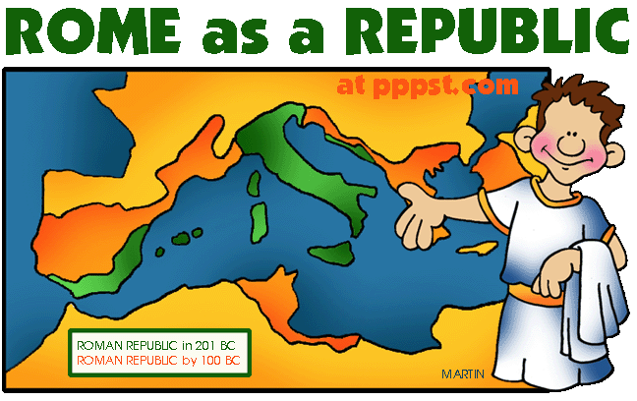

Slide 2
The Italian Peninsula
1000 km long
200 km wide
The Alps guard the northern border
Surrounded on three sides by Mare Nostrum ~ “our sea”
Divided by the Apennine Mountains – a diagonal barrier that divides much of the length of the peninsula

Slide 3
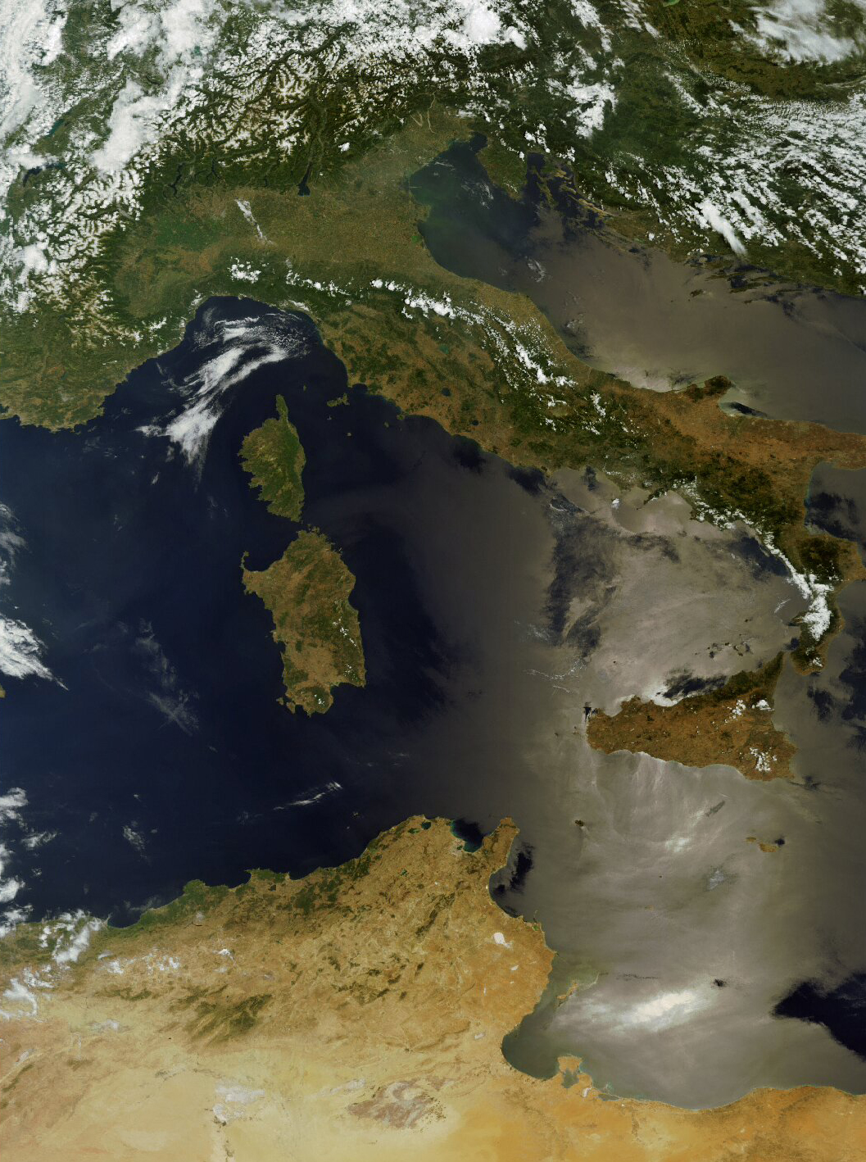

Slide 4
Land & Climate
Fertile land, but an expanding urban population made imported grain from Egypt and Sicily important
Mild temperature moderated by the sea, but could be hot in the summertime, expecially farther inland

Slide 5
The Myth of Romulus and Remis
Romulus and Remus
Latin princess was Vestal virgin
Raped by Mars, bore twin boys
Ordered killed by non-Latin king
Suckled by a wolf
Grew and founded a city (753BC)
Romulus killed Remus

Slide 6
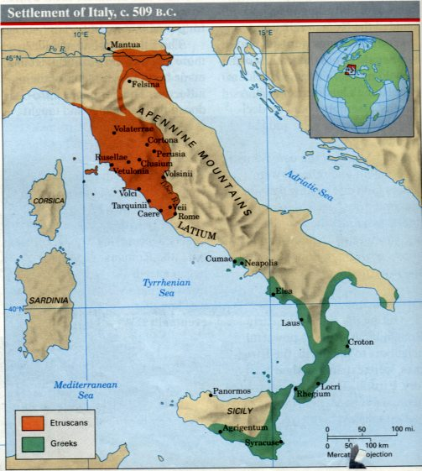
The Etruscans
Forerunners to Romans
Decorated their tombs to resemble the houses of the living
These showed many things we associate with the Romans:
Banquets
Gladitorial combat
Chariot races

Slide 7
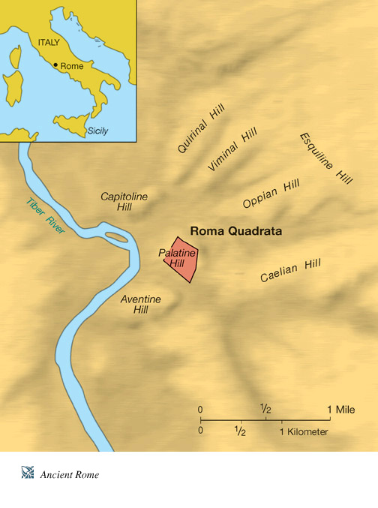

Slide 8
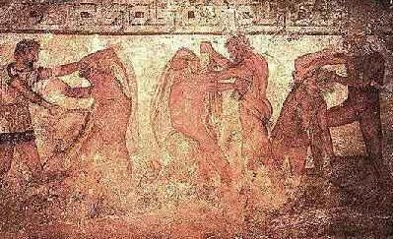
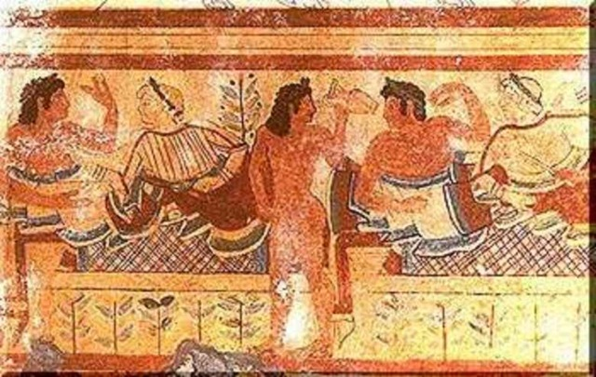
Etruscan Images

Slide 9
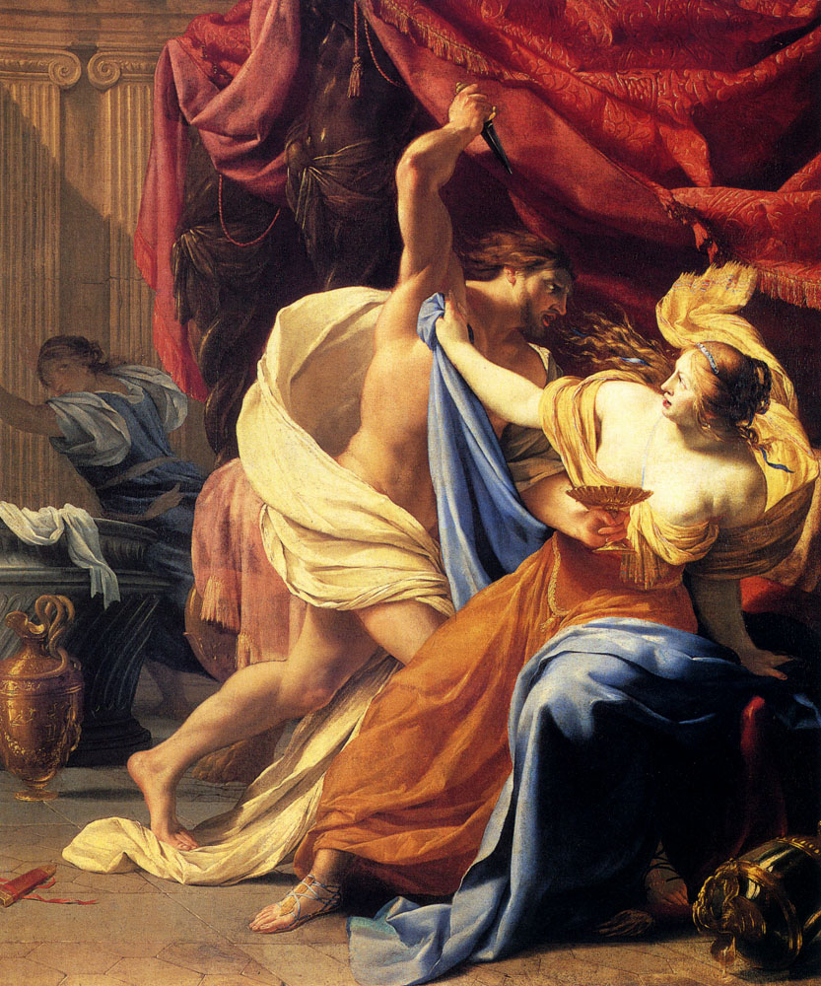
The Etruscan Monarchy
Loose confederation of city-states
Skilled artisans and traders
650 BCE expand into Rome
Transform what was really a village into a city
Drained marshes and built sewers
Introduced rectangular planning
Used the arch and vault in building
Introduced Greek culture and alphabet
By 500 BCE Rome was a great city
Last Etruscan King of Rome ~Tarquin the Proud ~ Rome rebelled after his son ~ Sextus ~ raped Lucretia, a Roman noblewoman

Slide 10
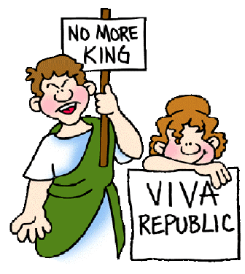
Roman Republic
Experience with tyrannical kings led Romans to establish a republic
Senatus Populusque Romanus (SPQR) ~ the Senate and People of Rome
Constant conflict between the patricians (aristocracy ) & plebeians (commoners)
Government of Rome evolved to accommodate this

Slide 11
Plebs vs. Pats
In 494 BCE Plebeians used their numerical
and military strength to force Romans to grant
them to hold political office and intermarry
with Patricians
--Plebeian revolt accomplished by literally
seceding from Roman state, leaving Patricians
militarily vulnerable
--By 287 BCE all Roman citizens were equal
under the law
--After 287 BCE intermarriage of Plebeians
and Patricians creates new class: “nobiles”
which dominates political offices

Slide 12
Republican Government
Senate
Senate (patricians) elected consuls (1 year term)
Never made laws but advice was accepted
Appointed censors (moral guardian/rank judge)
Appointed governors
Consuls:
Foreign affairs and the military
Each consul could veto the other – check on abuse of power
In times of crisis one would be appointed dictator for 6 months

Slide 13
Assemblies
Comitia Centuriata
All male segregated into electoral classes
Passed laws presented by senior magistrates
Comitia Curiata/Centuriata
Symbolic function
Comitia Tributa
Assembly of tribes consisting of the aristocratic class
Pass laws on behalf of all the people
Concilium plebis
Made all the laws (called plebecites)
Elected magistrates (administrators) and judges
All met in the forum (looked over each other)
Pontifex Maximus
Religious leader

Slide 14
Other Magistrates
Praetors
Most powerful after consuls
Responsible for justice and relations between Romans and non-Romans
Censors
Former consuls – public morality
Curulian Aediles
Civil servants - public works, standards & executions
Quaestors
Financial matters
Lictors
Bodyguards of the magistrates
Carried a Faeces – symbol of power to execute
This became the symbol of the Fascists in 20th century

Slide 15
Roman Forum

Slide 16
Roman Forum

Slide 18
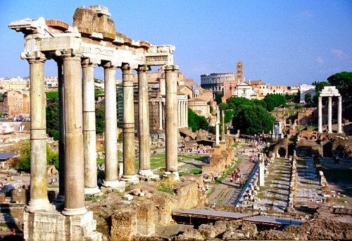
Roman Forum Today

Slide 19
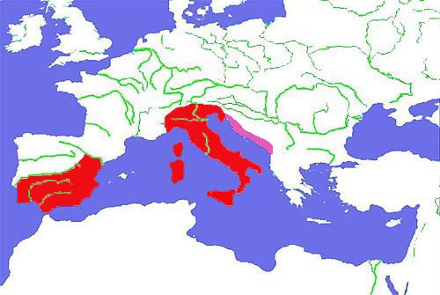
Roman Expansion (in Italy)
Conquest of Italy
Took 200 years
Granted full or partial citizenship
Tax and legal benefits
Developed loyalty in conquered Italian areas
Invasion by King Pyrrhus (pyrrhic victory)
Roman colonies
Established in strategic locations
Established by treaty
Troops sent when needed
Customs of the area left intact
Colonies were mostly for trade, with some military purposes

Slide 20
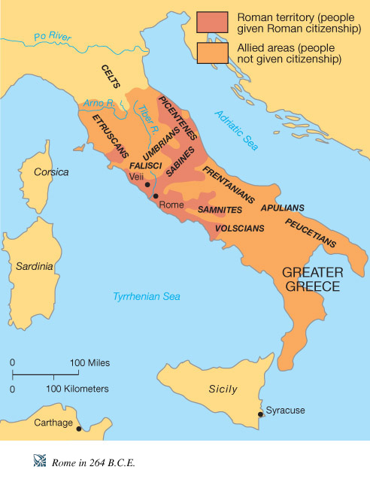

Slide 21
Rome Spreads Its Power
War with Carthage
Rome and Carthage begin the Punic Wars—three wars between 264 through 146 B.C.
Rome defeats Carthage and wins Sicily in the first 23-year war.
Hannibal, the Carthaginian general, avenges this defeat in the Second Punic War.
He attacks Italy through Spain and France, but doesn’t take Rome.
Rome Triumphs
Roman general Scipio defeats Hannibal in 202 B.C.
Rome destroys Carthage and enslaves its people in the Third Punic War from 149-146 B.C.

Slide 22
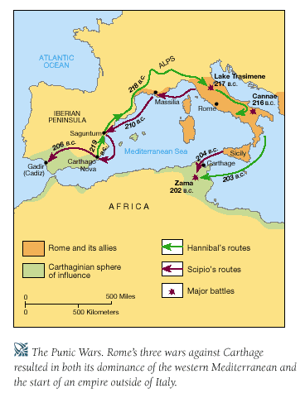

Slide 23
`
Hannibal crossing the Alps in the Second Punic War

Slide 24
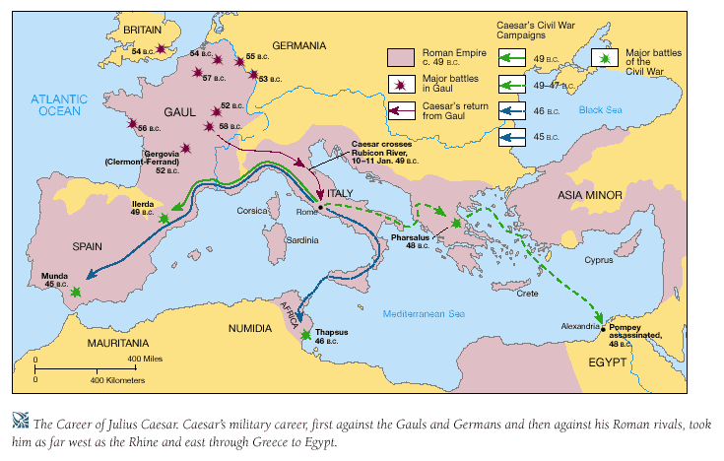

Slide 25
