Slide 1
Christianity
Paul
The “schism”
Reformation

Slide 2
Early Christianity
Apostle – followers of Jesus (12 disciples)
Another group of Christians had different ideas
Holy Spirit comes to all people
Relaxed approach to dietary restrictions
Baptism had equal value to circumcision as a sign of faith
This group was fiercely persecuted throughout the Roman Empire
The Christian teachings of the Apostles and other followers were tolerated in Jerusalem → kept the provisions of Jewish law

Slide 3
Paul (Saul of Tarsus) The “Second” Founder of Christianity
Saul was a Jew who was highly educated - literate in Greek, Roman and Hebrew culture & Roman citizen
One of the most devoted and successful persecutors of early Christians → probably participated in the stoning of Stephen (first martyr)
Had a deeply spiritual experience on the road to Damascus to persecute more Christians → confronted by Jesus → Converted to Christianity
Changed his name to Paul and became the most passionate and effective organizer of the early Christian church
Brought Christianity to the Gentile
Personal righteousness more important than righteousness to the law → no need for circumcision, dietary restrictions, distinctions between clean and unclean
Emphasis placed on the compassion and love of Jesus
Wrote nearly half of the books in the New Testament

Slide 4
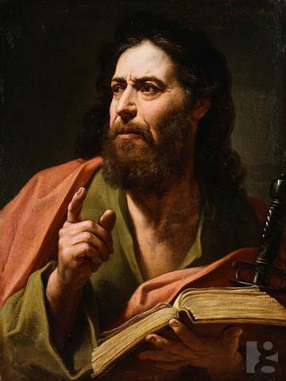
Paul’s letter to the Corinthians
1 Corinthians 13
New International Version (NIV)
13 If I speak in the tongues^{[a]} of men or of angels, but do not have love, I am only a resounding gong or a clanging cymbal. ² If I have the gift of prophecy and can fathom all mysteries and all knowledge, and if I have a faith that can move mountains, but do not have love, I am nothing. ³ If I give all I possess to the poor and give over my body to hardship that I may boast,^{[b]} but do not have love, I gain nothing.
⁴ Love is patient, love is kind. It does not envy, it does not boast, it is not proud. ⁵ It does not dishonor others, it is not self-seeking, it is not easily angered, it keeps no record of wrongs. ⁶ Love does not delight in evil but rejoices with the truth. ⁷ It always protects, always trusts, always hopes, always perseveres.
⁸ Love never fails. But where there are prophecies, they will cease; where there are tongues, they will be stilled; where there is knowledge, it will pass away. ⁹ For we know in part and we prophesy in part, ¹⁰ but when completeness comes, what is in part disappears. ¹¹ When I was a child, I talked like a child, I thought like a child, I reasoned like a child. When I became a man, I put the ways of childhood behind me. ¹² For now we see only a reflection as in a mirror; then we shall see face to face. Now I know in part; then I shall know fully, even as I am fully known.
¹³ And now these three remain: faith, hope and love. But the greatest of these is love.

Slide 5
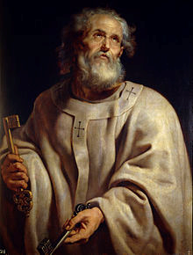
Peter “The Rock”
Among the first disciples to be called by Jesus
Prominent apostle in the New Testament – seems to be favoured by Jesus
Peter is the first to call Jesus “the Christ, the son of the living God”
Jesus in turn calls Peter his “rock” (Peter in Greek means rock) and says “on this rock I will build my church”
This implies Peter will be the founder of the Christian church
Peter establishes the Christian church in Rome
He is crucified by Nero upside down

Slide 6
The “Schism”
For nearly 400 years Christians were prosecuted by the Romans
Between 367 & 397 the New Testament is compiled – 27 documents
380 CE Roman Emperor Constantine makes Christianity the official state religion – spreads Christianity throughout Europe
Constantine moves capital of empire to Byzantium – renamed Constantinople
476 CE Rome collapses – Medieval period begins

Slide 7
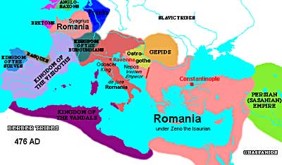
Roman Empire 476

Slide 8
Two Churches
As Christianity expanded into western Europe the Pope (Greek for ‘papas – father) increased influence
Roman Catholic Church
Peter established the church in Rome so all subsequent Roman Popes claim authority over everyone else Patriarchs of the church in Constantinople do not recognize this authority
Eastern Orthodox Church
The Patriarchs of the church in Constantinople do not recognize the authority of the Roman Pope

Slide 9
The Break – “Schism”
Much confusion in early Christianity regarding the Holy Trinity (God the Father, the Son & Holy Ghost)
Council of Nicaea (325 CE) issues a simple statement of faith – The Nicene Creed
In 587 the “Filioque “ clause was added by the Roman church – this states that both the Father and the son send forth the holy spirit
The Eastern church rejects this – leads to the first split of the Christian church: Roman Catholic & Orthodox

Slide 10
The Nicene Creed
We believe in one God, the Father, the Almighty, maker of heaven and earth, of all that is seen and unseen.
We believe in one Lord, Jesus Christ, the only Son of God, eternally begotten of the Father, God from God, Light from Light, true God from true God, begotten, not made, one in Being with the Father. Through him all things were made. For us men and for our salvation he came down from heaven: by the power of the Holy Spirit he was born of the Virgin Mary, and became man.
For our sake he was crucified under Pontius Pilate, he suffered, died, and was buried. On the third day he rose again in fulfillment of the Scriptures; he ascended into heaven and is seated at the right hand of the Father. He will come again in glory to judge the living and the dead, and his kingdom will have no end.
We believe in the Holy Spirit, the Lord, the giver of life, who proceeds from the Father and the Son. With the Father and the Son he is worshiped and glorified. He has spoken through the Prophets. We believe in one holy catholic and apostolic Church. We acknowledge one baptism for the forgiveness of sins. We look for the resurrection of the dead and the life of the world to come. Amen.

Slide 11
The Reformation
Martin Luther – German monk and scholar
Luther disappointed with practice of Christianity – not following scripture
1517 Luther posts 95 theses on how the Roman Catholic Church should reform
Ideas rejected – Luther is excommunicated (booted out of the church)
Luther’s reforms unleash 500 years of religious wars throughout Europe, between Protestants and Catholics
Churches that rejected Roman Catholic faith were known as the protest religions → Protestant Church

Slide 12
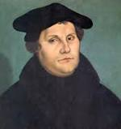
Martin Luther
Significance:
Only acts identified in scripture should be practiced
Rejected much of the ritualistic traditions of the church
Emphasized salvation by faith – faith = knowing God’s word → Christians must read – protestant regions see growth of literacy = dominant economic and political force (Swizterland, Germany, Holland, England and parts of France)

Slide 13
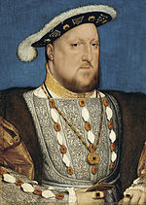
King Henry VIII
1534 King Henry VIII breaks with the Roman Catholic Church over the Pope’s refusal to grant him an annulment to his marriage
Establishes the Church of England – Anglican Church (Episcopalian Church in USA)

