Slide 1
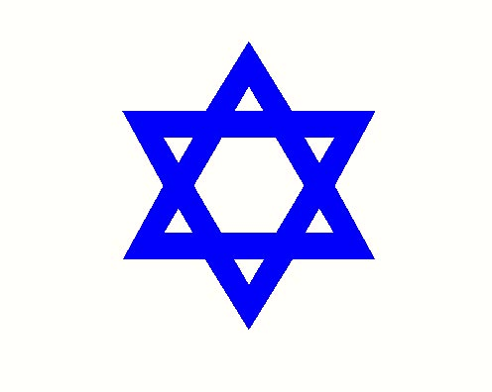
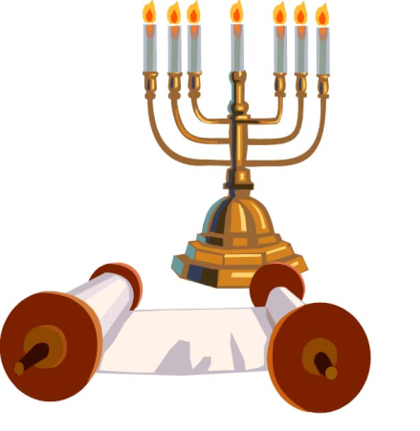
Judaism
Beliefs
Practices & Symbols

Slide 2
Beliefs: G-d
Jewish beliefs centre on the idea of one G-d
Creator of everything
Governor of the universe: justice and honour
G-d is immaterial (not of this world)
G-d cares for the world and all of its creatures
Bible refers to G-d as YHWH – no one knows the true meaning of this – the name given to Moses means “I am in the process of becoming”
The words Lord or Adonai (master) and Elohim are often used

Slide 3
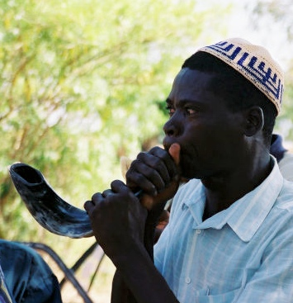
Who are the Jews?
One is either born Jewish (mother must be Jewish) or one can convert into Judaism (gerut)
To be Jewish is both a religious and cultural expression: one can identify with being Jewish without following religious rituals
To be Jewish is not a genetically linked trait – Jewish community includes peoples of diverse backgrounds
A “Chosen People” – does not mean superior – G-d chose Abraham, but Abraham chose to listen to G-d. The Jews are to be an example of God’s law

Slide 4
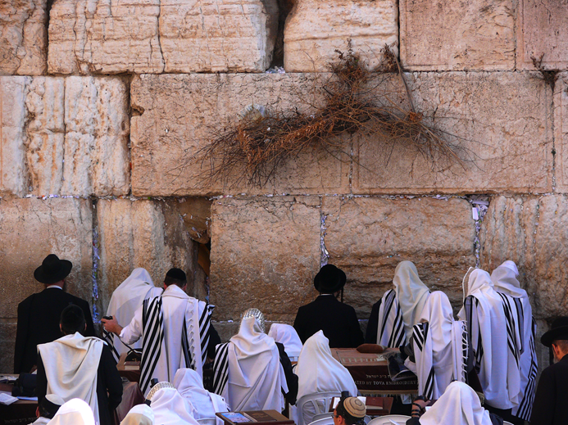
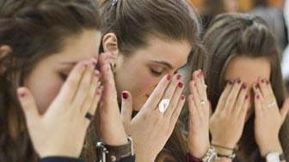
How do Jews Honour G-d?
The covenant (G-d’s promise) is a fact of life
Life itself in a covenant – one must keep G-d in one’s mind always
Devotion shown through study of Torah, prayer and good deeds
Mitzvah – good / righteous action
Bible contains 613 mitzvoth

Slide 5
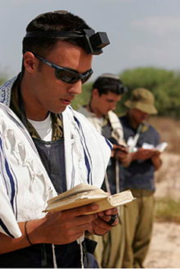

Slide 6
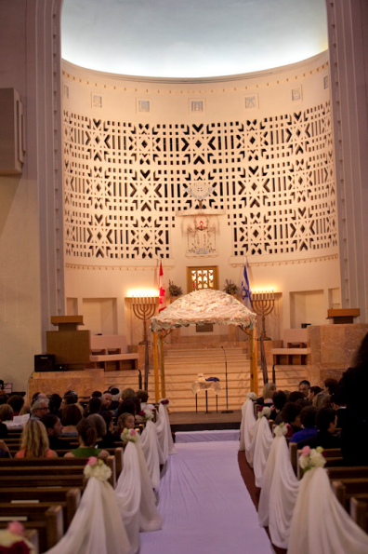
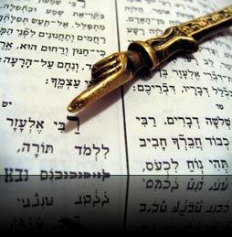
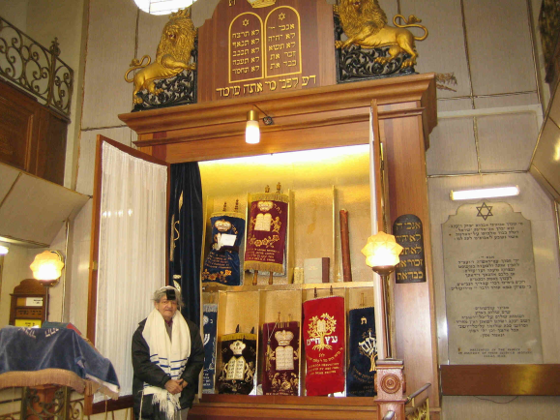
The Synagogue & Torah Scroll
The synagogue is the communal place of worship for Jews
Often referred to as shul – a Yiddish word for the German word school
Sefer Torah - Torah Scroll is the text of the Five Books of Moses – the heart of the Jewish Bible – most holy object of Judaism
Readers use a pointer so as not to touch the scoll
The Torah is kept in the Holy Ark (cabinet) in the synagogue
The Torah is Judaism – it has united a people over distance and time for thousands of years

