Slide 1
Psychology:Behavioural and Humanist

Slide 2
Behavioural
The two most important Behaviourists are:
Ivan Pavlov – Classical Conditioning
B.F. Skinner – The Skinner Box and Operant Conditioning
These two scientists did their work in the first half of the 20th century and were interested in learning about ways to understand and change behaviour.

Slide 3
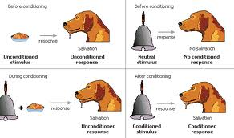
Pavlov is famous for his experiment with his dog and responses to stimulus as a way to understand and change

Slide 4
Pavlov’s findings determined that classical conditioning is one way that nearly all organisms learn to adapt to their environment.
Classical conditioning can be used by psychologists to encourage changes in detrimental behaviours by manipulating the conditioning to encourage more favourable behaviours.

Slide 5
Skinner
Skinner is famous for his work on operant conditioning which he did using pigeons and rats and a Skinner Box.
His work established the effects of punishment and rewards in determining behaviours. i.e. A behaviour that is followed by a reinforcing stimulus will result in an increased probability of the behaviour occurring in the future.

Slide 7
If rewards for behaviours do not continue when the behaviour occurs then the behaviour will become extinct this is called extinction.
Positive and Negative reinforcement methods are used today to treat anxiety, phobias and panic disorders. It also is applied to theories of learning to modify students’ behaviours in the classroom, and the general public in society.

Slide 8
Intermittent Reinforcement has the least chance of extinction. This form of reinforcement is the principle at work in Casinos. It keeps gamblers gambling.

Slide 9
Humanist Psychologists
Abraham Maslow – Hierarchy of Needs
Victor Frankl – Logotherapy
Carl Rogers – The Client Centred Model
Humanist psychology became important in the second half of the 20th Century

Slide 10
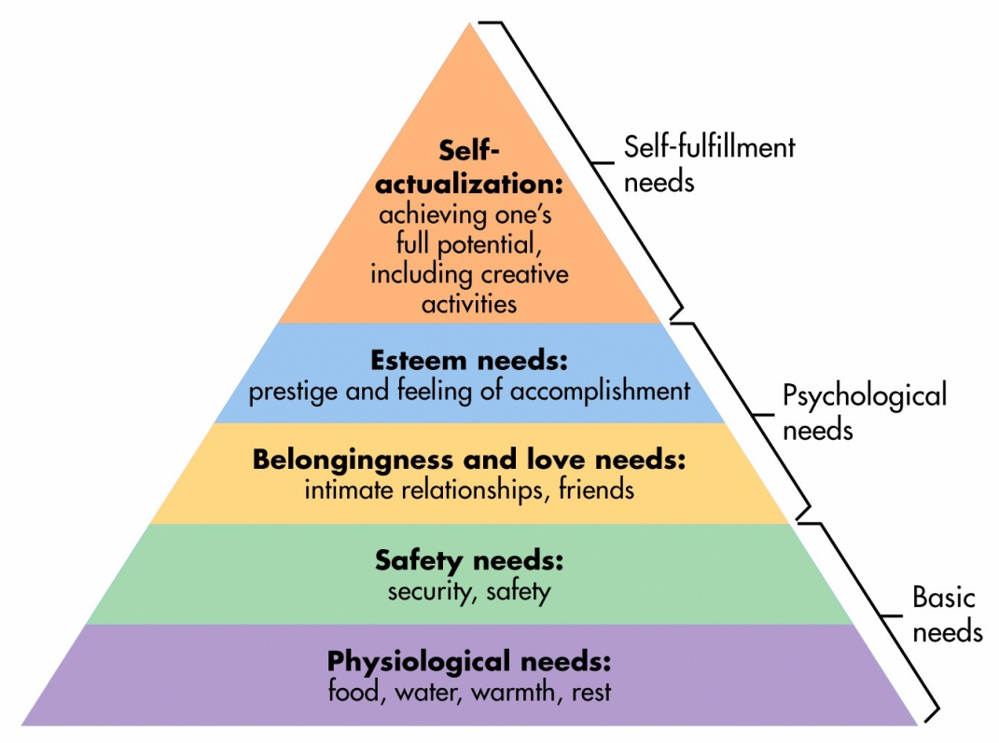
Abraham Maslow (1908-1970)
Interested in how people succeeded in life – how were they motivated.
We are motivated to act based on a “hierarchy of needs”
People reach their full potential only if physical and psychological needs are met.
Critique:
Not based on scientific analysis
Too rigid – assumes you have to move step by step
Even Maslow acknowledged other factors can affect motivation (values, culture, conditioning)
Concept of ‘self-actualization” based on analysis of highly educated white males

Slide 11
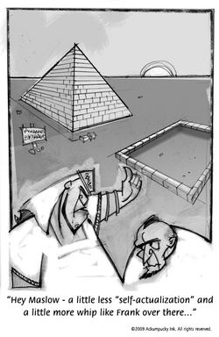
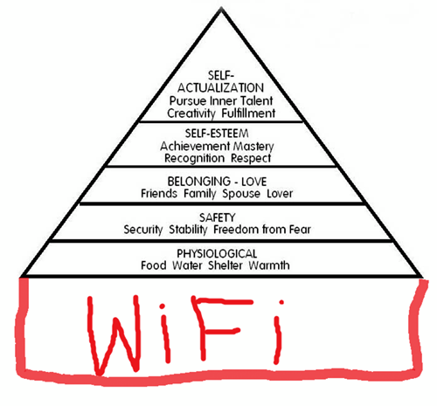

Slide 12
Viktor Frankl (1905-1997)
Nazi concentration camp survivor
Studied behaviour of people in Auschwitz – Nazi concentration camp during WWII
His observations suggested that those who survived often did so because they had hope, great faith or meaning in their lives – something to “hold onto”

Slide 13
Logotherapy
Logotherapy (spirit or meaning) form of psychotherapy that tries to help patient find meaning in their life
Suggests that humans are motivated by a need for meaning ~ those who cannot find meaning will possibly become depressed.
We have ‘freedom of the will” ~ we can choose how to respond to situations and thus have the power to shape our own lives.

Slide 14
Carl Rogers (1902-1987)
Client-centred therapy ~ focuses on potential of each person to realize personal growth and self-awareness
Focuses on present and future & values the conscious, rather than past conflicts & the subconscious
Believed that people were basically good and had the need to self-actualize.
Therapist helps the client explore their attitudes and problems through talk therapy to see how their attitudes and problems related to their patterns of behaviour. Client plays active role in their own therapy – improved self concept
Improved self concept leads to change in negative patterns of behaviour

Slide 15
Rogers’ client-centred approach has become the basis of modern psychotherapy.
Answer questions 1 and 2 on page 71 and question 2 on page 70 (in green highlight)

Slide 16
The Cognitive Revolution
Albert Bandura – Social-Cognitive Theory
Elizabeth Loftus – False Memories

Slide 17
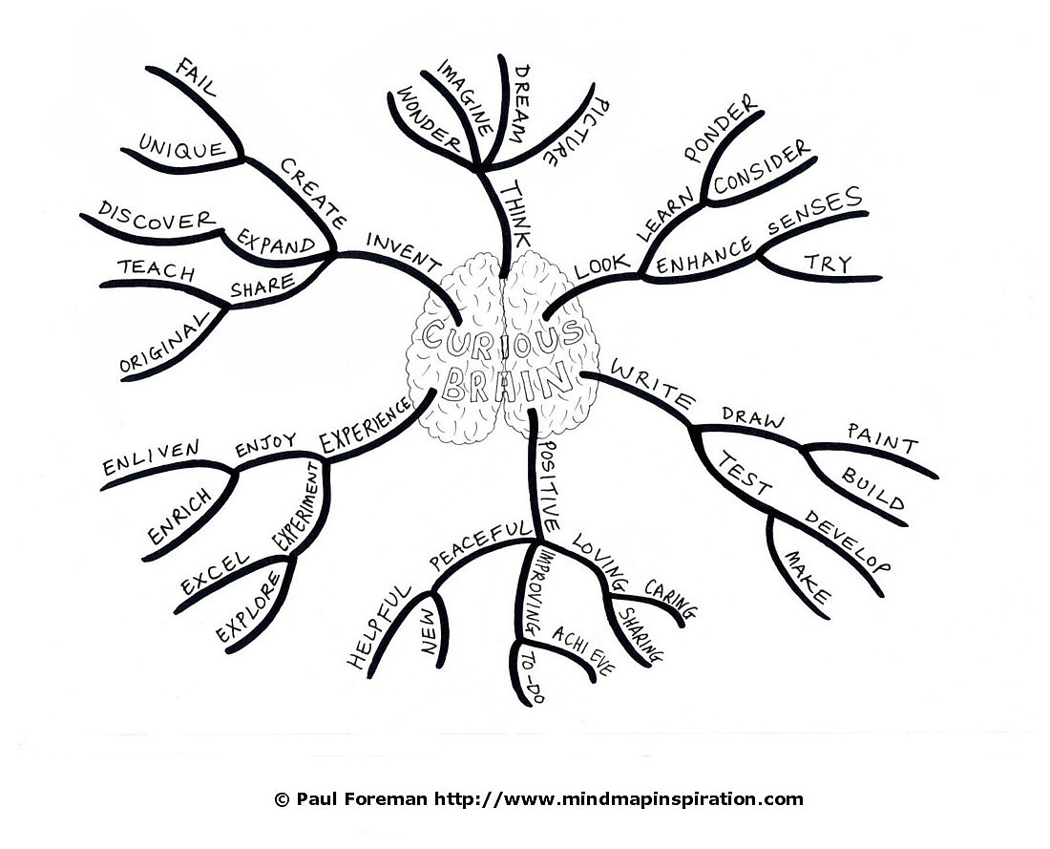
Cognition: The mental processes in the brain associated with thinking, knowing and remembering.
The study of how the BRAIN learns!

Slide 18
Cognitive psychologists blend the ideas and theories of mental states such as: beliefs, motivation and desires (like Psychodynamic theorists and Humanist theorists), with Behavioural theories, to develop methods to treat mental illness and neurotic disorders.

Slide 19
Albert Bandura
Canadian psychologist, originally a Behaviourist, became part of the cognitive revolution
HIS QUESTION? Why does the same situation generate different behaviours from different people or even the same person?
HIS ANSWER: He developed social cognitive theory which takes a person’s personality, motivation, environment and behaviour into account in order to predict changes in individual and group behaviour
Go to Youtube video BOBO doll experiment

Slide 20
Bandura’s basic assumptions:
Humans are products of learning i.e. we become what and who we are because of what we are taught
Humans have an infinite ability to understand symbolization – thus language – and language enhances learning

Slide 21
Bandera's MAJOR IDEA
Reciprocal Determinism:
Humans are influenced by three things which in turn influence each other.
Biological and genetic factors, our attractiveness and our health for example, Social status
Thoughts, memories – i.e. what we think is a determiner of who we are

Slide 22
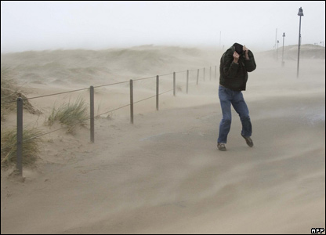
2. Our environment – where we are, the conditions we live in, the people and world around us
3. Our behaviour – we are
influenced by what we do
ourselves, for example:
you are uncomfortable so
you start moving your chair

Slide 23
Bandura also saw personality as having an ego but he called it a “self-system”
We are what we think and we divide our thoughts by thinking about:
ourselves others the world
And…. since Bandura, psychologists have added:
the future

Slide 24
These ideas are used by cognitive theorist to very effectively treat people with depression.
Depressed people usually Think:
About themselves: I am worthless
About others: No one will or can help
About world: Is an unfriendly/dangerous place
About the future: It won’t get better
These are faulty conclusions and so a cognitive psychologist will challenge people to prove that their thoughts are true.

Slide 25
Self Efficacy – is the cognition (belief) about one’s own ability to do a behaviour that will lead to a desired outcome.
i.e. A CAN DO ATTITUDE
Self efficacy is specific to a particular belief. That is I may have high academic efficacy that is the belief that I can learn easily and well. Or I may have high social efficacy, I believe I make friends easily and am well liked.
Where does it come from? Cognitive theorists believe it comes from learning and mastery of something.

