Slide 1
Agriculture & Merchants and Trade
By Wezley,Bronson,Bianca,Furkan and Samantha

Slide 2
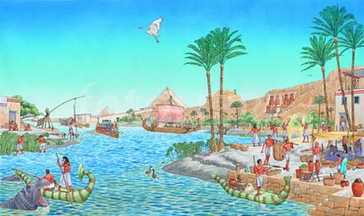
Ancient Egypt
Agriculture

Slide 3
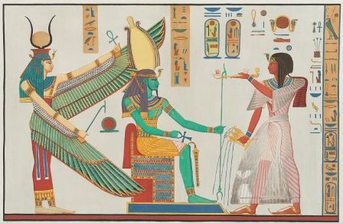
Behind these kings and queens were pawns, behind these temples, palaces and pyramids were the workers of the cities and the peasants of the fields of Ancient Egypt Agriculture.
No one really owned the land that they claimed, it was really just owned by the Pharaoh.

Slide 4
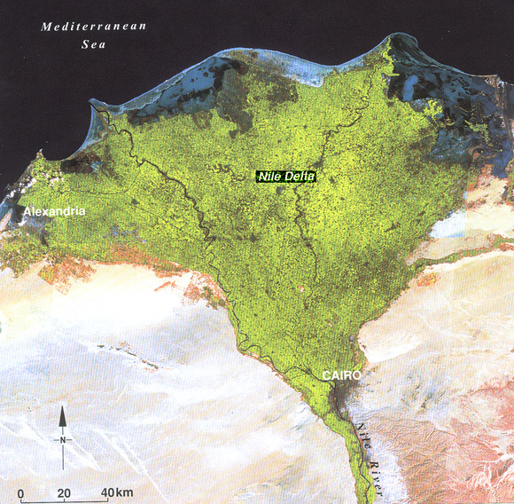
Ancient Egypt farming
The Nile delta is one of the most fertile regions on earth. Many stories of ancient Egypt involve the Nile river and farming. From ancient to modern times, agriculture has been an important facet of Egyptian life. Egypt has 6 million fertile acres of the Nile delta.
The Great civilization was split into two parts of the land.

Slide 5
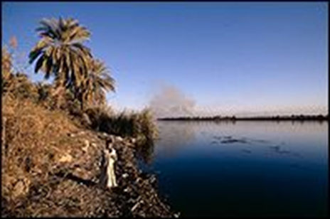
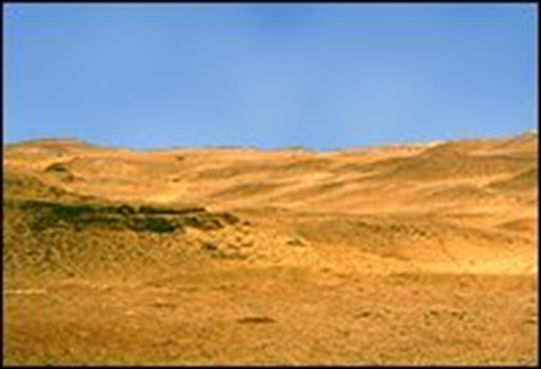
The Two Lands
The Black Land
The black land was the most fertile part of Egypt
They used this part of Egypt to grow all of there crops and this is were they had all of there lush resources
This was the only part of land that they could grow crops on. This is because the land was coated with a rich layer of silt that came from the Nile when it flooded threw
The Red Land
The red land was the desert parts of Egypt where they got all there minerals
This also offered protection to them

Slide 6
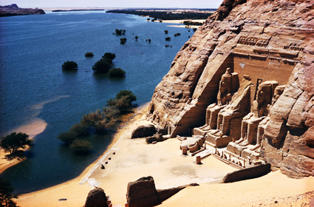
The Nile river
the Nile played a major role in the building of civilizations. The civilization of ancient Egypt was indebted to the Nile River and its dependable seasonable flooding.
The river’s predictability and the fertile soils it provided allowed the Egyptians to build an empire on the basis of great agricultural wealth.

Slide 7
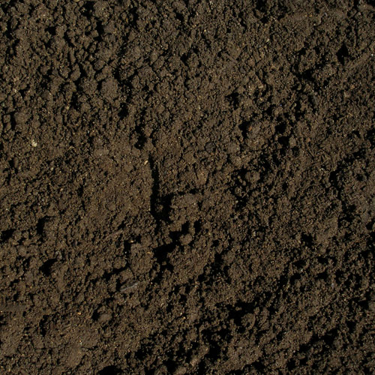
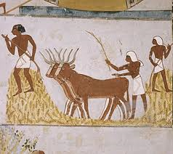
How they grew crops
The Egyptians had very soft and wet soil which made growing crops easy and simple for them.
They would plant the seeds in the soil and would use animals to stomp on it, to churn it up
During the growing season the crops were cultivated
The Egyptians needed the right floodplain level to have successful harvest
They also used there own form of irrigation system to help with the process.

Slide 8
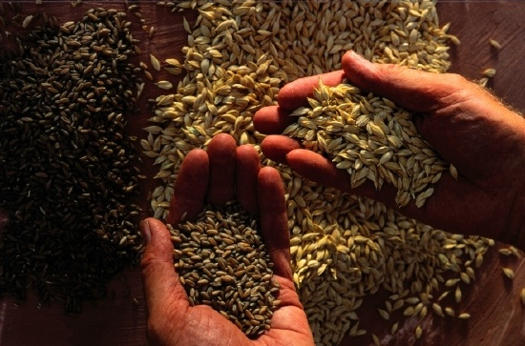
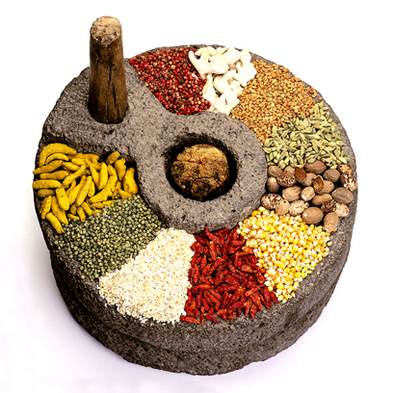
What did they grow ?
They grew barley, wheat, and a great amount of grains.
They grew vast amounts of wheat, enough to secure the city and left overs to trade.

Slide 9
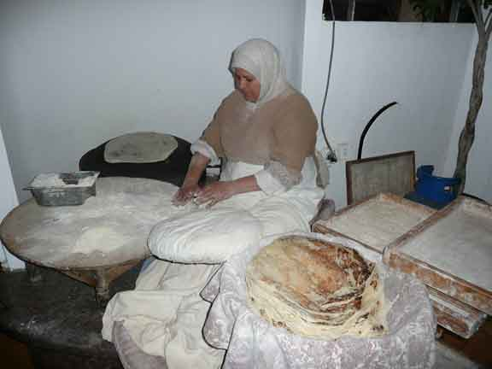
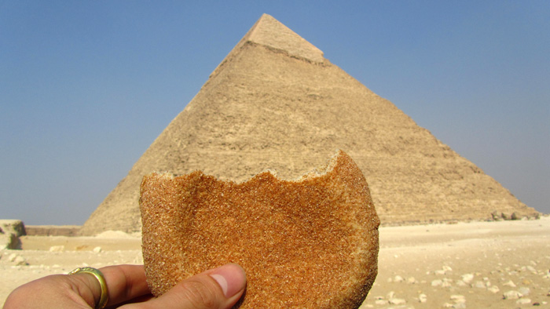
They grew vegetables such as onions, leeks, lettuce, radishes, ground, melons, peas and lentils flex.
Dates, pomegrates and figs.
They grew wheat and barley from which they made bread and beer.

Slide 10
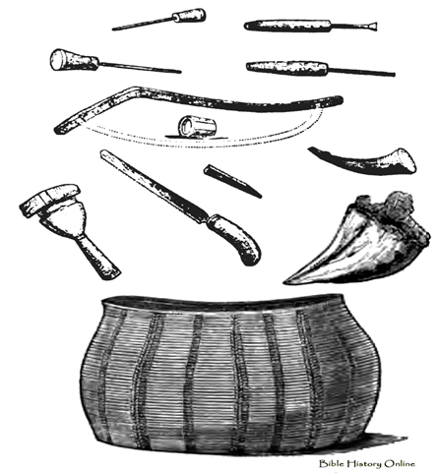
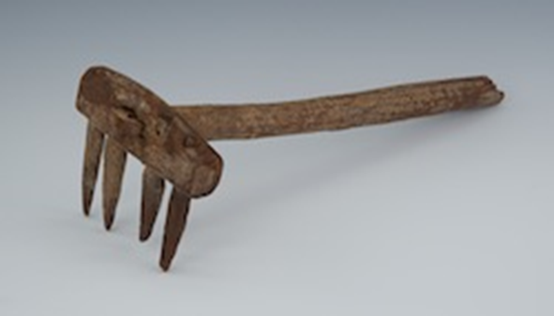
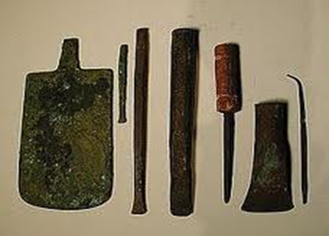
What tools they used
They had tools such as
Scoops, hoses, rakes, flint-bladed sickle plows, scoops and mattocks.
They Egyptians plow had a small blade but didn't cut very deeply, but that was okay because the soil was fertile.

Slide 11

Question Time
Who owned the land that the laborers worked on?
2) Why is the River significant?

Slide 12
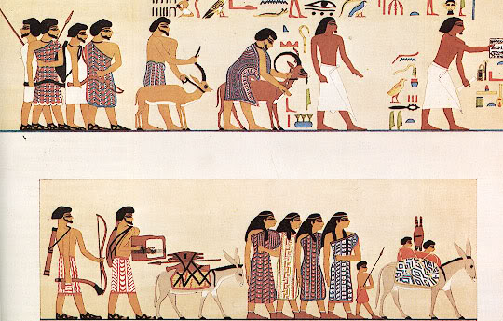
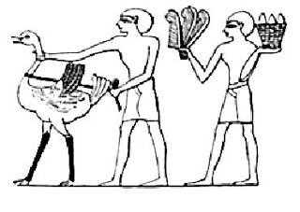
What is a Merchants?
A merchant is a person or company involved in wholesale trade, they mostly deal with countries or supplying goods to a particular trade.

Slide 13
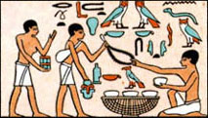
What Merchants do?
Ancient Egyptian merchants were people that exchanged luxury or household items that were made in Egypt to other countries.
Merchants would bring the imported goods to Egypt and sell them to the Egyptians.
Ancient Egyptian merchants would trade their goods for grain and other things for their own family.
Merchants were highly regarded they traveled trading goods and selling goods in different places.
Merchants also traveled down rivers.

Slide 14
What Merchants do? (con’t)
Merchants would trade exotic items the Egyptians to get what they needed.
Merchants carried and sold these objects:
Gold
Papyrus rope
Linen cloth
Jewelry
Cedar
Ebony Wood
Elephant Tusks
Fruit
Vegetables
Oil
Wine
Fowl

Slide 15
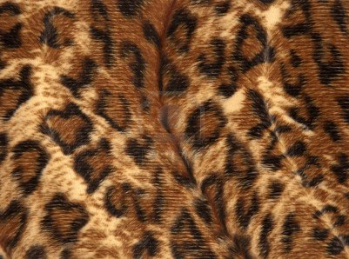
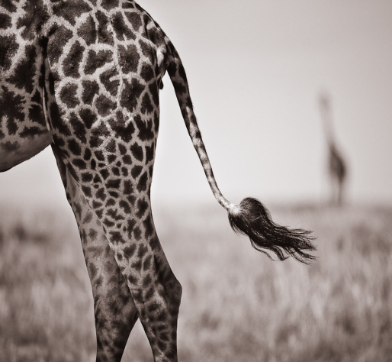
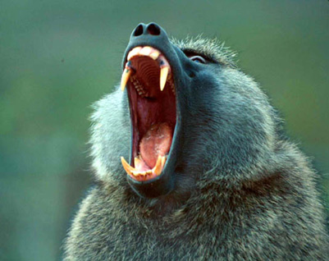
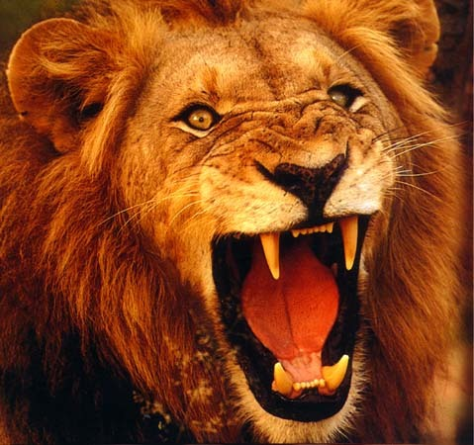
What they brought back
Egypt was one of the wealthiest countries in the ancient time.
The Merchants brought back panther skin, giraffe tails for fly whisks and some animals like baboons and lions for the temple.

Slide 16
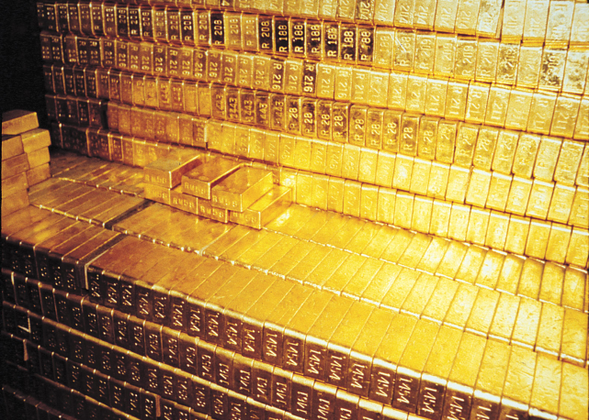
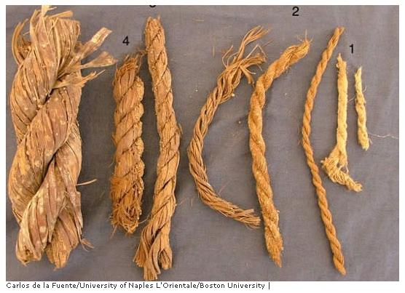
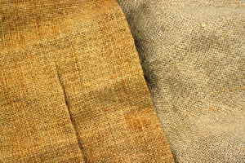
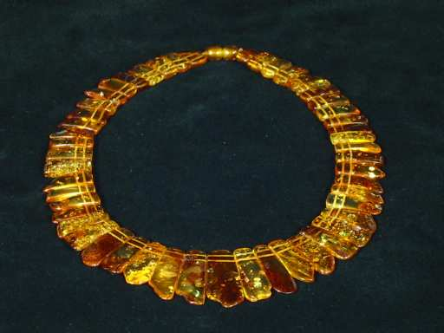
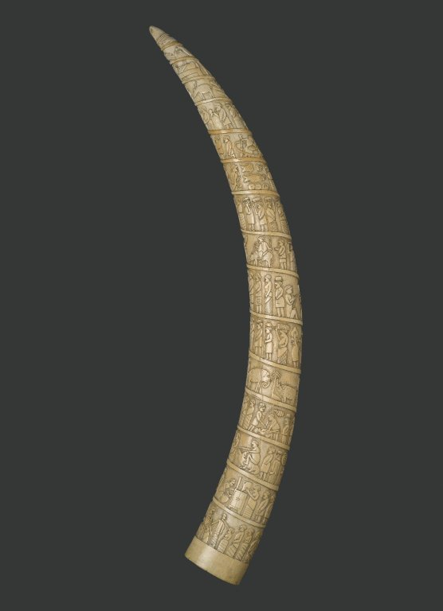
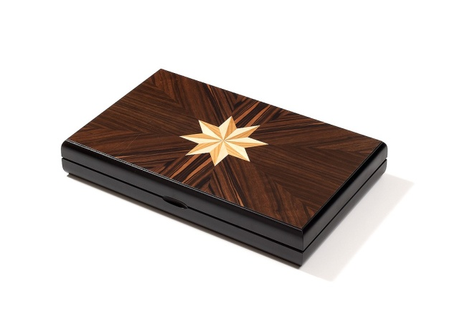
Pictures

Slide 17
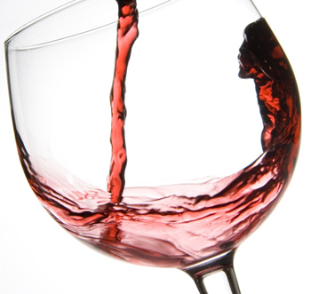
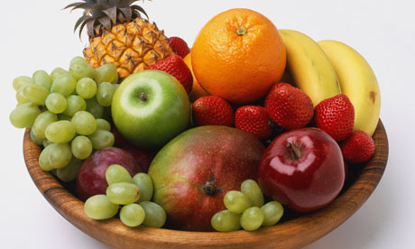
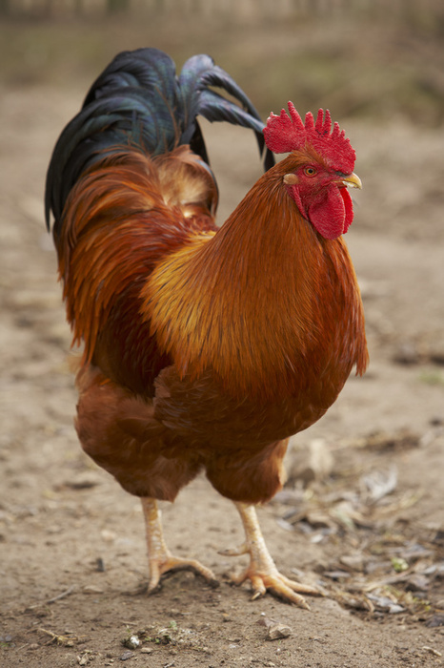
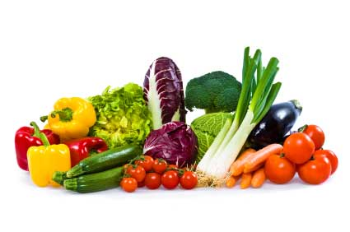
Pictures

Slide 18
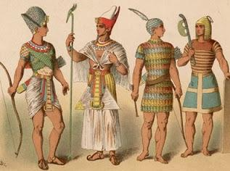
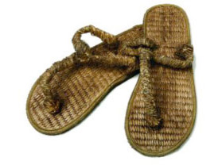
What Merchants Wore?
Merchants usually wore kilt made out of cloth and linen.
When the weathers got colder they added cotton on their top.
They would wear leather sandals on their feet.

Slide 19
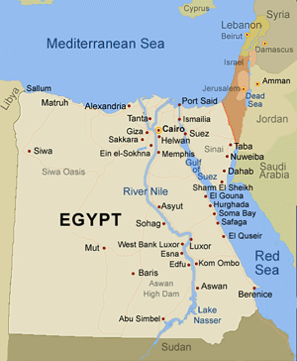
Where they traded & Who they traded with?
Merchants in ancient Egypt depended on the Nile River to transport their goods.
They used boats to go through the river.
Money was not used at that time, merchants would trade goods of equal value.
Merchants would trade with countries around the Mediterranean Sea, Aegean Sea and the Red Sea.

Slide 20

Questions
Which river did the Egyptians use to sell goods from?
What did the Egyptians get in return?
Name eight (8) goods which the Egyptians sold?

Slide 21
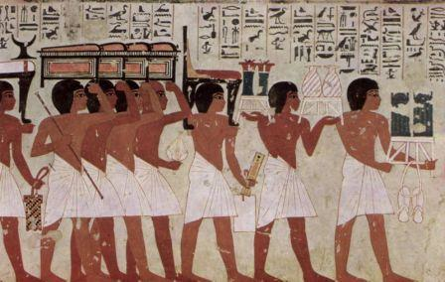
Ancient Egypt: Trade

Slide 22
What is trade?
Trade is the act of buying and selling goods.
Trade is also the process of which, different civilization trade cultures.
Trade is also used to make peace and show respect between cultures.

Slide 23
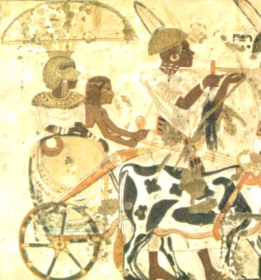
How did they trade? And did it change over the years? (Con’t)
They traded by bartering. This is done by equivalent exchange. This means trading something of the same value for something else. If something is not of the same value, they would get more of that object which increases the value.
Example:
3 goats+1 pig + wheat/barley = Wood coffin
Overtime, after trading with civilizations like Greece, and Rome they began using metal coins because this is what the European civilizations were accustom too. Instead of bartering, the trade became modern. Meaning something that is close to what we would do. In 400 BCE gold, silver, and bronze coins became Egypt's currency.
Example:
1 goat = 100 coins( copper)

Slide 24
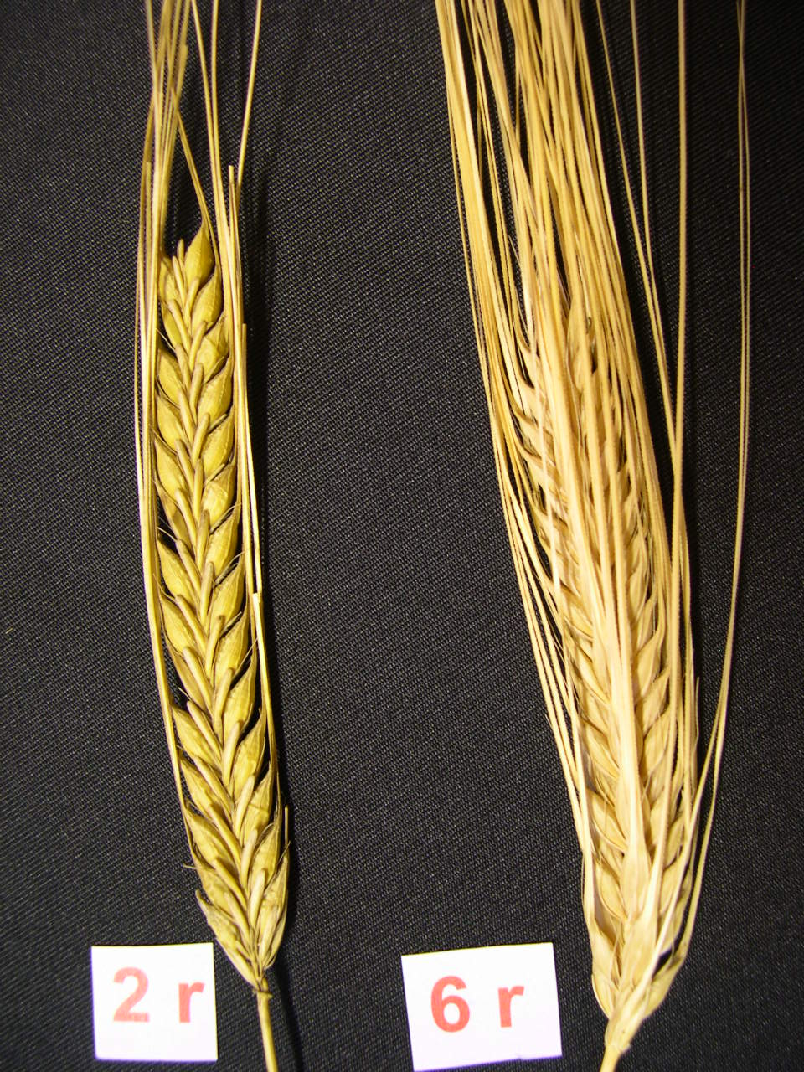
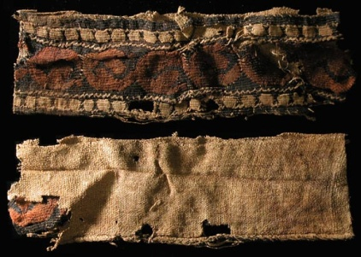
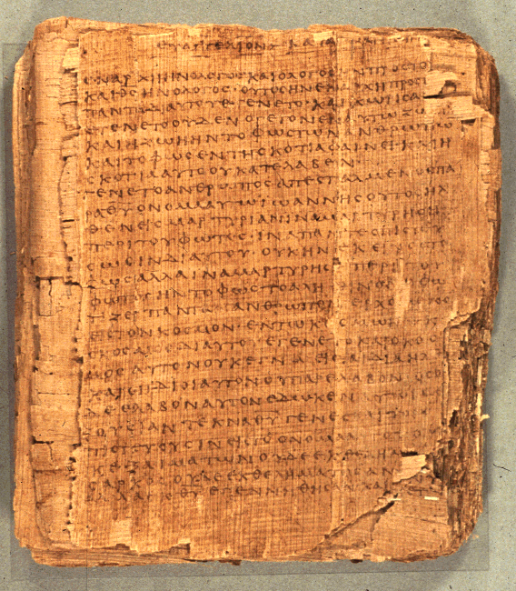
What did they trade?
They traded many things like gold, papyrus, linen, grain, and artifacts( stolen from the Pharaoh's tomb)

Slide 25
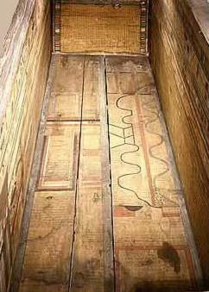
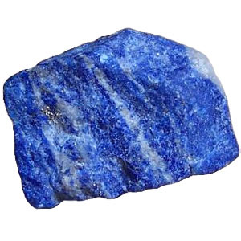
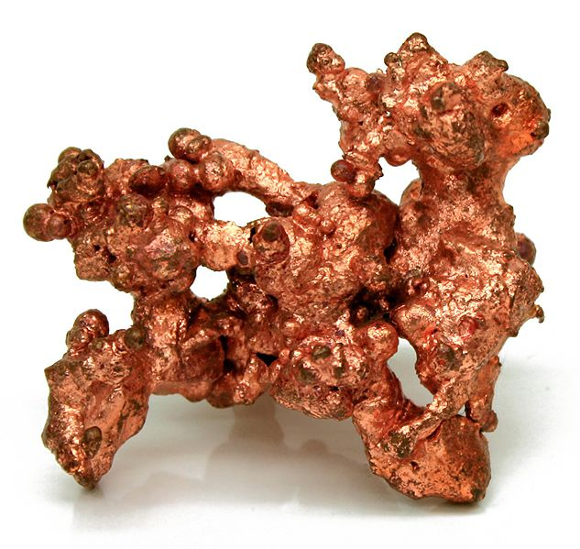
Who did they trade with?
Items that were received they weren’t commonly found in Egypt.
Cedar was from Lebanon. Ebony and Ivory was from Africa. Lapis Lazuli was from Afghanistan.
Gold was from Nubia and important metals( copper and iron) were from the best allies.

Slide 26
Questions?
What are three things that Ancient Egypt traded with?
A) linen, Grain, Papyrus
B) Trading cards, Games, numbers
C) Lapis Lazuli, Ebony and Ivory, Gold
How did the Ancient Egyptians trade?
A) Bartering
B) Purchasing using coins
C) Hugs and Kisses
D) Both A and B

