Slide 1
War on the Home Front
By: Megan, Becca, Justin, and Matthew
Notes:
hello

Slide 2
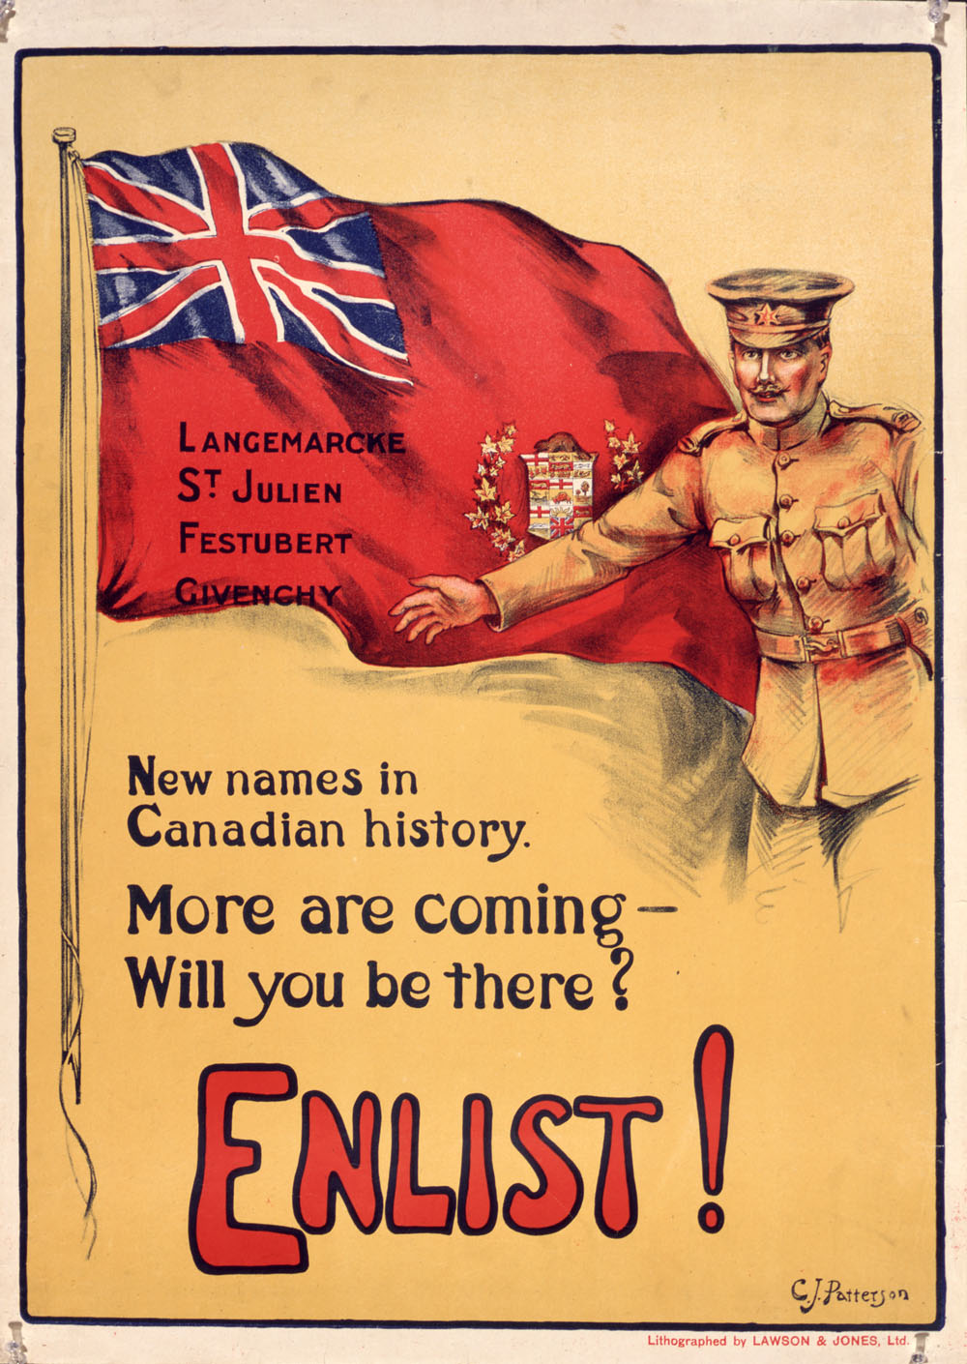
What sacrifices were made at home?
Our nation’s population in 1914 was just under 8 million
632,000 served throughout the 4 year war
425,000 of these soldiers travelled overseas to the warzones
172,000 wounded, 60,000 dead

Slide 3
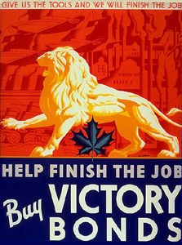
Victory Loan Campaign
The Government’s Victory Loan Campaign was the primary funding for financial aid to the British
In 1917, the government asked for $150 million, Canadians gave them $398 million
By 1919 $1.49 billion in donations were raised to put an end to the war
National debt rose from $463 million to $2.46 billion from 1913 to 1918

Slide 4
The Halifax Explosion
On December 6, 1917, two ships collided in Halifax’s harbor
One of them was carrying ammunition going to Europe
This was the biggest man made explosion before the atomic bomb
9000 people were wounded, 2000 were killed
25,000 houses and buildings were torn to pieces
We were trying to help Britain as much as we could, we could not take care of ourselves

Slide 5
Conclusion
This country was not prepared to have this much of an effect on the war
Before The Great War, we had no war experience
This was apparent when we made counted costly mistakes fighting in Europe
Our victories such as Vimy Ridge gave us respect in warfare
This was our first time being viewed at as more than a British colony
Our country suffered greatly during this difficult time, although the independence, experience, and respect we gained made us much stronger

Slide 6
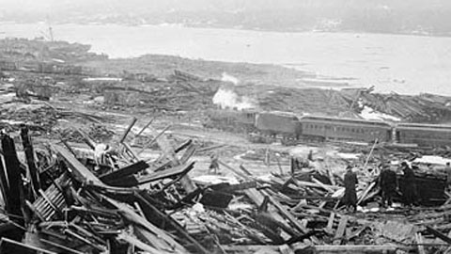
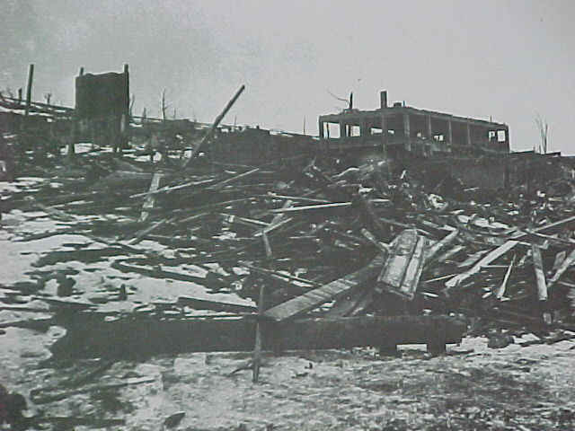
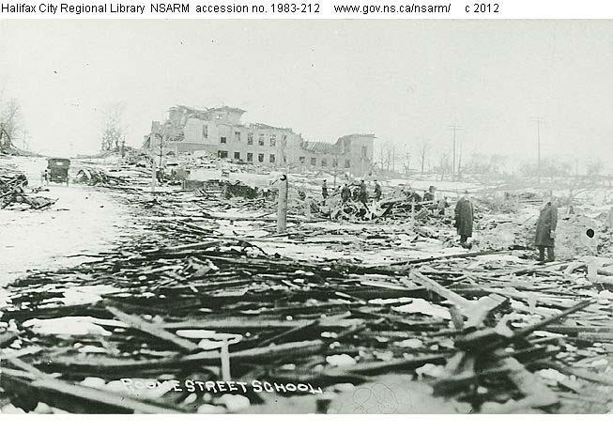
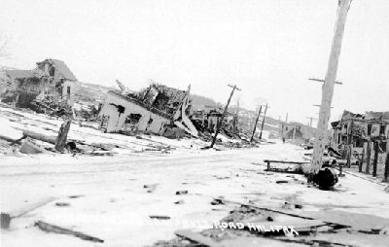

Slide 7
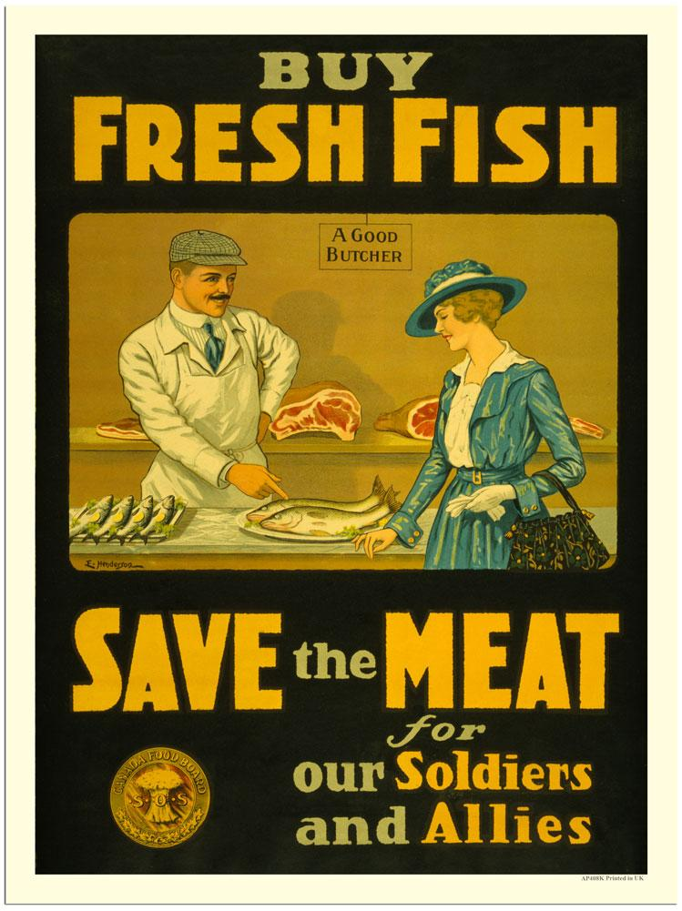
Rationing
To make better use of Canada's limited resources rationing was introduced.
Government officials began monitoring and limiting consumption of food, gasoline, and building materials.
Gov. created the Canada Food Board to increase production and encourage less consumption.
Main foods that were rationed are
Flour
Beef & Pork
Sugar
Butter
These food items were then shipped to Europe and given to soldiers and allied troops

Slide 8
Reducing Food Consumption
Canadian government introduced many new rules:
No fancy bread
No French pastries
No food items in liquor distillation
Sugar in candy was to be reduced by 50%

Slide 9
Government Suggestions
Food controller’s office released a suggested weekly consumption for a family of five
Advice was extended to housewives
If you were found to be carelessly wasting rationed items, you were prosecuted

Slide 10
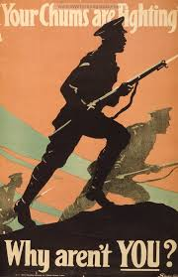
Propaganda
During the war the government needed full support from the citizens in order to be successful
To do so they used a tool called Propaganda
Propaganda is usually in the form of posters, advertisements, and newspaper articles
Used to spread government favourable ideas, and to suppress the adverse
Propaganda was usually used to persuade people to do, and or buy something

Slide 11
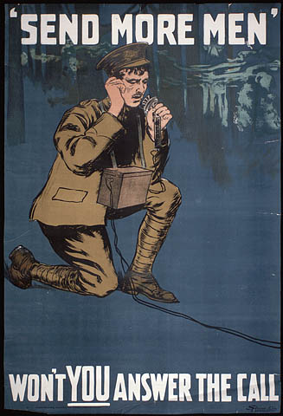
Propaganda Posters
Posters were one of the most important methods
Gov. officials invested in eye catching posters
At beginning of the war they reflected optimism and hope
Towards the end they shifted to desperation and cries for help
Often the government used guilt, and the hatred of the enemy as motivation to support the war
Began asking government officials, Religious groups, and civic organizations to spread propaganda by word of mouth

Slide 12
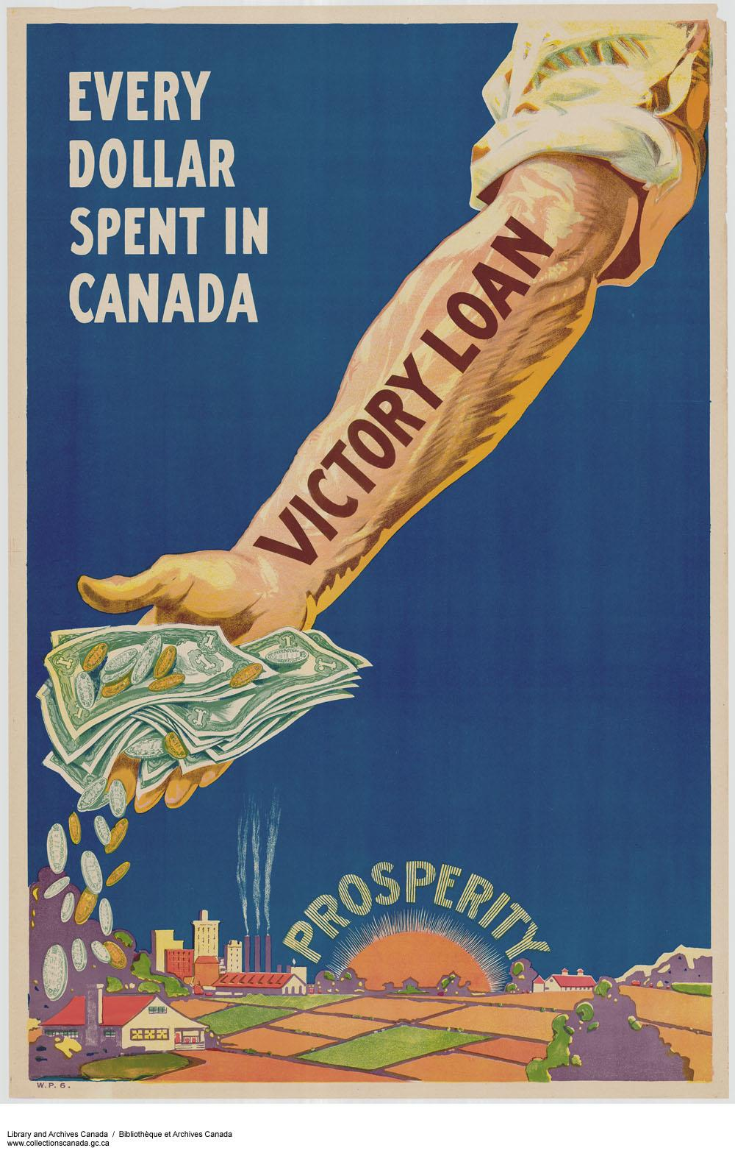
Types of Posters
Some of the most common propaganda poster topics were:
To buy war victory bonds (loans made out to the government)
To try and encourage men to enlist in the army
Rationing/ food and necessity conservation
Encourage women to pursue jobs in hospitals and factories

Slide 13
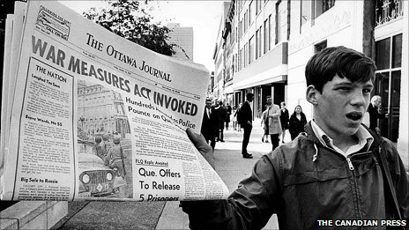
Newspaper Censorship
It was crucial that certain information was not released
This was solved by the War Measures Act
This allowed government to censor newspapers
Usually the government would censor the publication of
Enemy air raids
The amount of damages
The number of hits,
The names of places hit
Information Published was often incorrect
Victories were exaggerated
Losses were downplayed

Slide 14
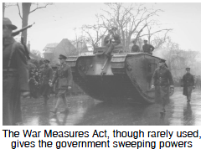
War Measures Act
In 1914 the War Measures Act was implemented
This allowed the government to make decisions based on the circumstances of the war
For example, they didn’t allow bread makers to make fancy bread because the wheat needed to be saved for the soldiers
Also, the government made farmers come work and make artillery for the army because the demand became very high

Slide 15
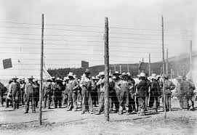
Internment Camps
People from Austria-Hungary, Germany, Ukraine and other countries were put in internment camps
They were considered “enemy aliens”
These camps were not a daycare, but they were a prison
Approximately 8000 people were put into these camps
More than 100 people died from internment camps, and this is considered one of Canada’s darkest times

Slide 16
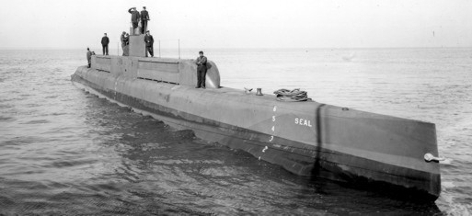
Attacks in Canada
Although most of the battles happened on the other side of the ocean, there were attacks in British Columbia as well as on the east coast of Canada
German submarines sank 100 Canadian ships
This is relevant because it meant Canada had to use expenses to replace those ships
As well it put fear into those who lived on the coasts of Canada

Slide 17
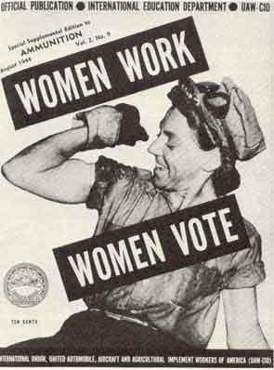
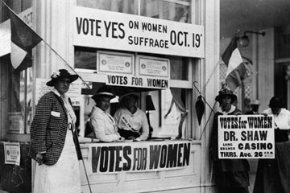
Women Voting
When World War One started, people protested for women to be able to vote
This changed society in a big way
One example is that it created controversy because not everyone would have wanted this law to be passed
Also, since women are able to vote, there could be a change in who gets elected
This means that there could have been different decisions made by government throughout history
Women being able to vote not only changed society in 1914 but from that point onward as well

Slide 18
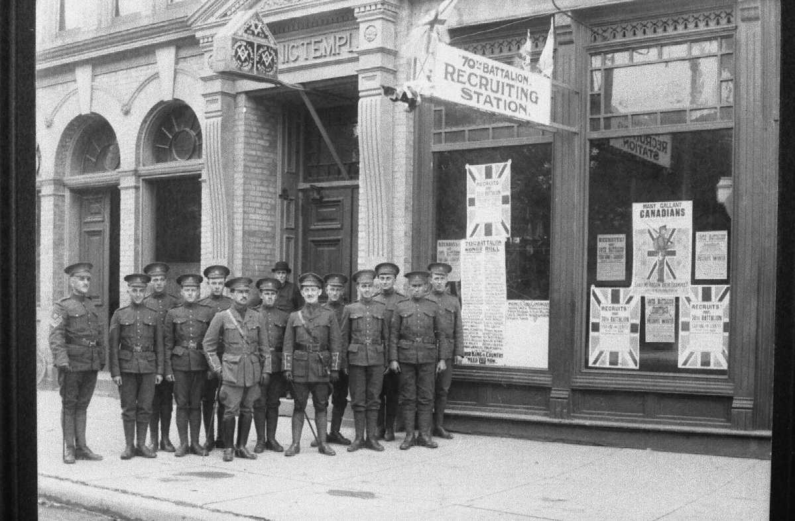
CONSCRIPTION CRISIS:
Beginning of World War I
Canadians reacted with excitement and patriotism
Practically all English Canadians contributed to the war effort
many young men enlisted
French Canadians didn’t feel attached to Britain
less than 1 in 20 volunteers for service were French

Slide 19
Rates of Enlistment Drop
By 1917 the rate of enlistment had dropped for many reasons:
Canadians had learned about the bad conditions on the front
Jobs wear now more plentiful and higher paying at home
Enlistments were too low to replace soldiers lost in battle

Slide 20
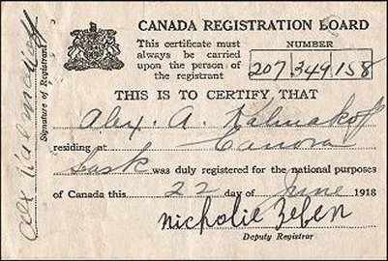
Conscription
Prime Minister Robert Borden retracted his earlier promise
Introduced the Military Service Act
Many Canadians supported the act, others were very against it

Slide 21
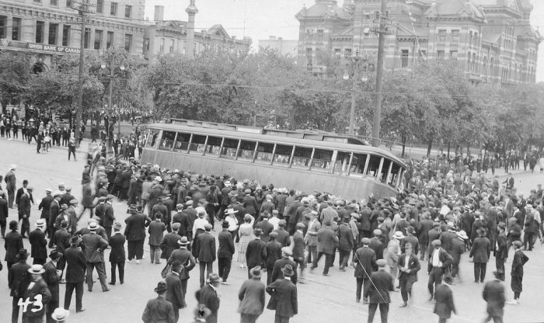
The Military Service Act
Illustrated the strong divide between French and English
Some English Canadians were opposed to it → The French were much more outraged
Passing of the Act was responded to with protest:
Store windows were smashed
Tramway rails were ripped up
Army registrar offices were looted
Soldiers were sent into Quebec City
TOTAL: 4 civilians killed, dozens more injured

Slide 22
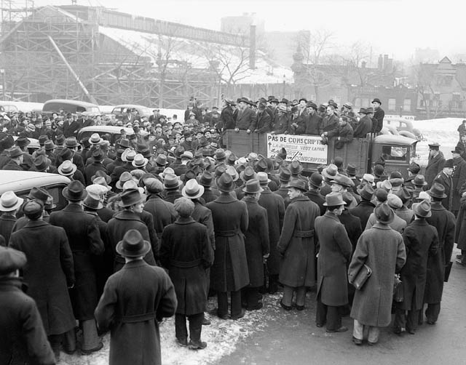
French-English Divide
French Canadians felt very strongly about conscription
French felt that their rights were not being respected
Intense distrust was created between French and English Canadians

Slide 23
Thank You!

