Slide 1
Classical Greece
The Athenian Empire
The Peloponnesian War
Philip of Macedon & Alexander the Great

Slide 2
The Delian League
Defeated Persia in 479 BCE & claimed small parts of the coast of Asia Minor
Athens proposed an alliance to ward off any future Persian attack – Sparta opposed
Aristides organizes the Delian League to defend Greece
Each state sign a treaty and contribute to maintaining a fleet in the Agean
Athens provided all officials and commanders
Treasury and meetings held on island of Delos – Delian League
Membership soon became manditory
Lead by Kimon, the league defeats the Persians in 467 BCE and Pericles leads the liberation of Cyprus shortly after
A defeat to the Persians in 450 BCE prompts Pericles to move the treasury to Athens – beginning of the Athenian Empire

Slide 3
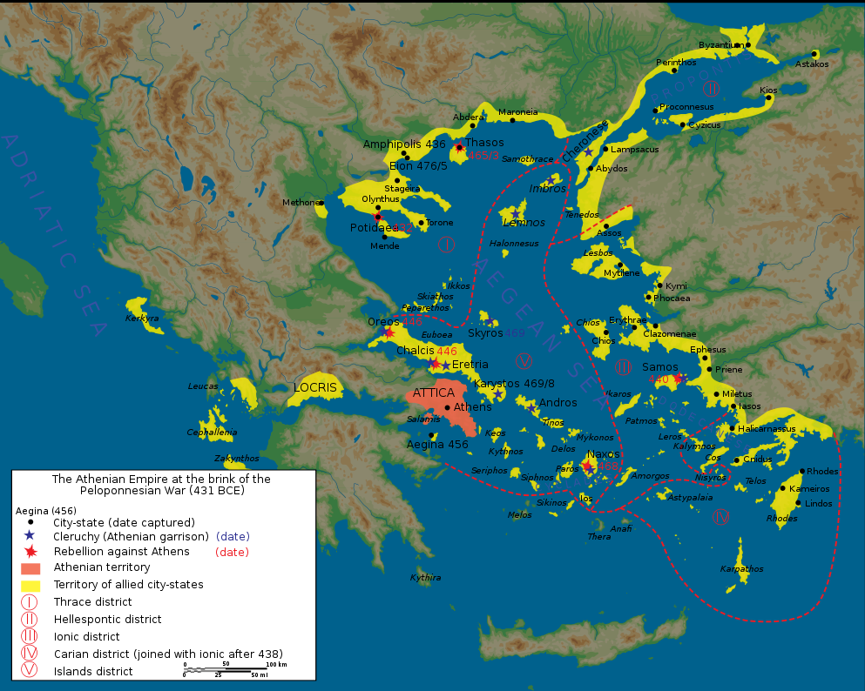
Delian League

Slide 4
Pericles & Democracy
Pericles was the greatest leader of ancient Greece
Democracy under Pericles
Every citizen could speak & vote on every piece of legislation in the Assembly
Every citizen had an equal chance to hold public office
Law cases determined by majority vote of citizen juries

Slide 5
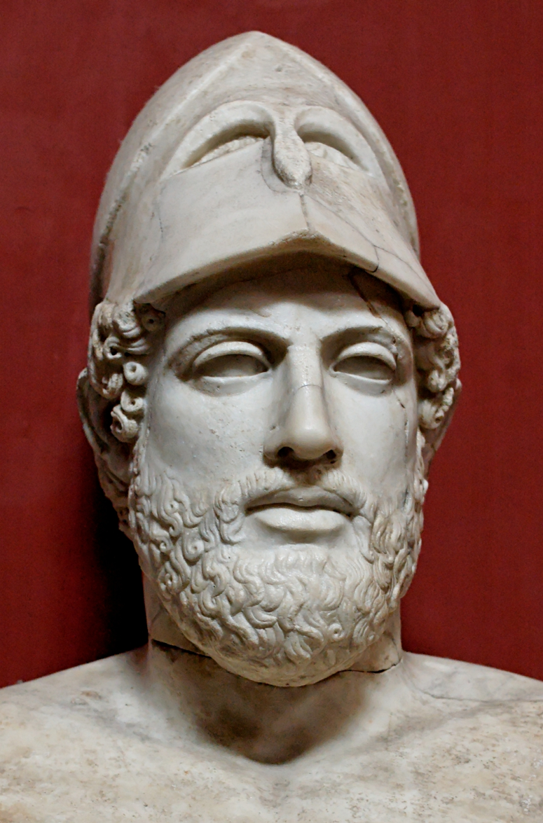
Pericles (495-429 BCE)
“We judge the man who takes not part in public affairs a useless, not just a quiet, person”
“Freedom is the sure possession of those alone who have the courage to defend it.”
“Everyone is equal before the law”

Slide 6
http://www.youtube.com/watch?v=7QNrRSYo7lg

