Slide 1
Causes of the Great Depression
Underlying Problems in the Canadian Economy

Slide 2
Buying On Credit
Consumer confidence
Farmers borrowed $ to buy more land and equipment
High Debt
Have to pay interest – less $ to spend on other things
Economy slows down
Fewer goods sold leads to less production, job losses
Canadians are buying new luxuries on credit

Slide 3
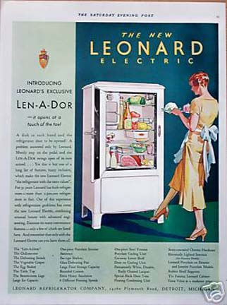
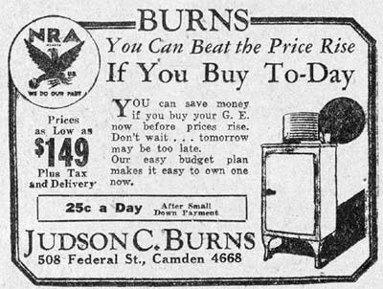

Slide 4
Overproduction of Goods
Buying on credit
High demand for goods
Companies stockpiled goods in warehouses for future sales
Oversupply of Goods
Too much inventory
Less demand for goods (supply & demand are inversely related)
Economic Slow Down
Less production needed
Job losses, people have less $ to spend

Slide 5
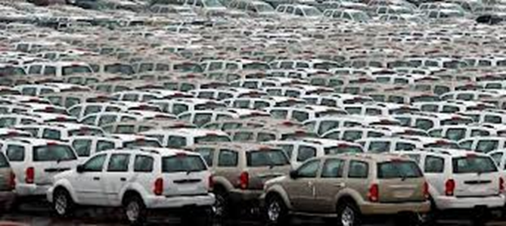

Slide 6
Low Standard of Living
Not all Canadians prospered during the 1920’s: maritime workers, farmers of crops other than wheat, factory workers on low paying jobs.
In the USA approximately 5% of the population received more than 25% of the national wealth!
Many did not have money to spend and keep the economy going → weakening economy

Slide 7
Tariffs
To protect businesses and jobs the governments around the world began to raise tariffs (taxes) on imported goods
US raises tariffs on imported goods by 50% in 1930
Less trade = fewer sales → Loss of production → loss of jobs → weakening economy

Slide 8
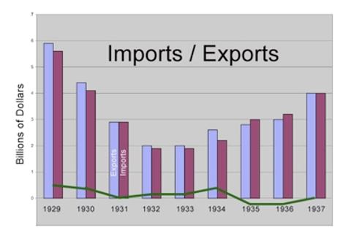
USA Trade

Slide 9
Canada’s economy dependent on sale of natural resources to other countries (wheat, lumber, coal, iron ore)
1929 → major drought hit the prairies → lack of water, high temperatures and plagues of locusts turned the land into “dust-bowls”
Other countries (Australia, Russia, Argentina) had excellent crops of wheat → price of wheat falls →
Price of wheat in 1928 = $1.29/bushel; 1932=$0.34!
Canadian farmers cannot afford to pay off debts – they cannot even afford to harvest their crops!!
Over supply – less demand for resources
Economic slow down as Canadians continue to lose $ & jobs
Less $ flowing into Canadian economy through trade

Slide 10
The Collapse of the Stock Market
Prices for shares in companies collapsed for two reasons:
Slow down in production → less profits → investors realized their shares were not worth as much as they paid for them
Job losses = slow down in spending and investmentz → less demand for stocks→ prices decline
October 29, 1929 “Black Tuesday” → investors tried to sell all their shares at once → almost total collapse of stock prices
On New York Stock Exchange 16,419,030 shares traded and $9,000,000,000 was lost!!!
In Toronto and Montreal → 16 companies lost over $300,000,000!

Slide 11
The Great Depression Had Begun
Overnight millionaires became poor and average people lost virtually everything.
No welfare or Employment Insurance meant entire families became homeless

